Slide 1
The Birth of Greek Tragedies and Aeschylus
朱振宇

Slide 2
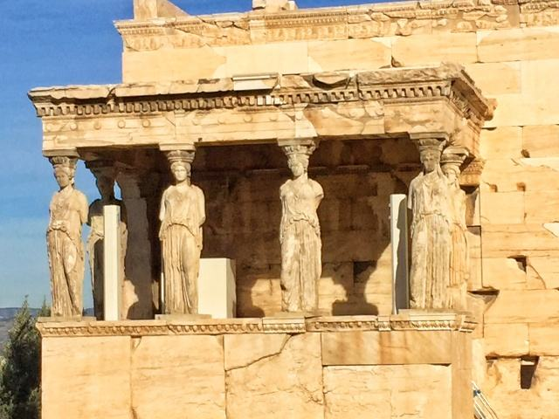
Athens

Slide 3
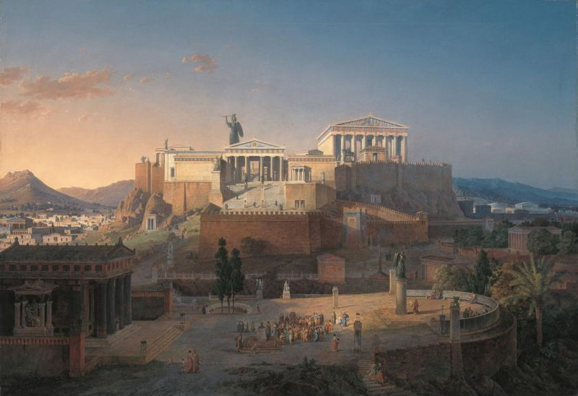

Slide 4
Classical Athens and its democracy
Rise to power (508–448 BC)
The Persian Wars; Battle of Salamis
Athenian hegemony (448–430 BC)
Pericles and the Athenian Golden Age
Peloponnesian War (431–404 BC)
Corinthian War and the Second Athenian League (395–355 BC)
Athens under Macedon (355–322 BC)
The period from the end of the Persian Wars to the Macedonian conquest marked the zenith of Athens as a center of literature, philosophy and the arts .
Great names of Athens: Aeschylus, Aristophanes, Sophocles, Euripides, Socrates, Plato, Aristotle, Herodotus, Thucydides, Xenophon.

Slide 5
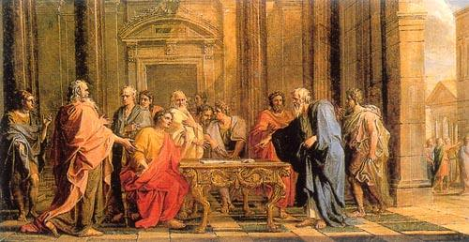
Solon (638 B.C—559B.C.） his Reforms and the Rise of Democracy in Athens

Slide 6
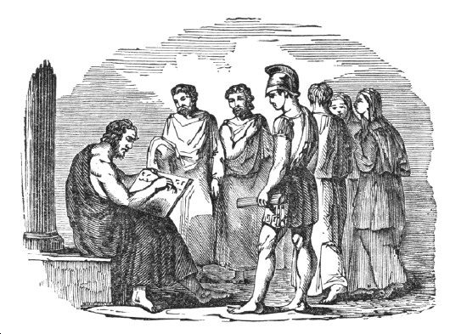

Slide 7
First coming to prominence (c. 600 B.C.) for his patriotic exhortations when Athens was fighting a war against Megara for possession of Salamis, Solon was elected eponymous archon in 594/3 B.C. and perhaps, again, about 20 years later. Solon faced the daunting task of improving the condition of:
1. debt-ridden farmers
2 . laborers forced into bondage over debt, and
3. the middle classes who were excluded from government,
while not alienating the increasingly wealthy landowners and aristocracy. Because of his reforming compromises and other legislation, posterity refers to him as Solon the lawgiver.

Slide 8
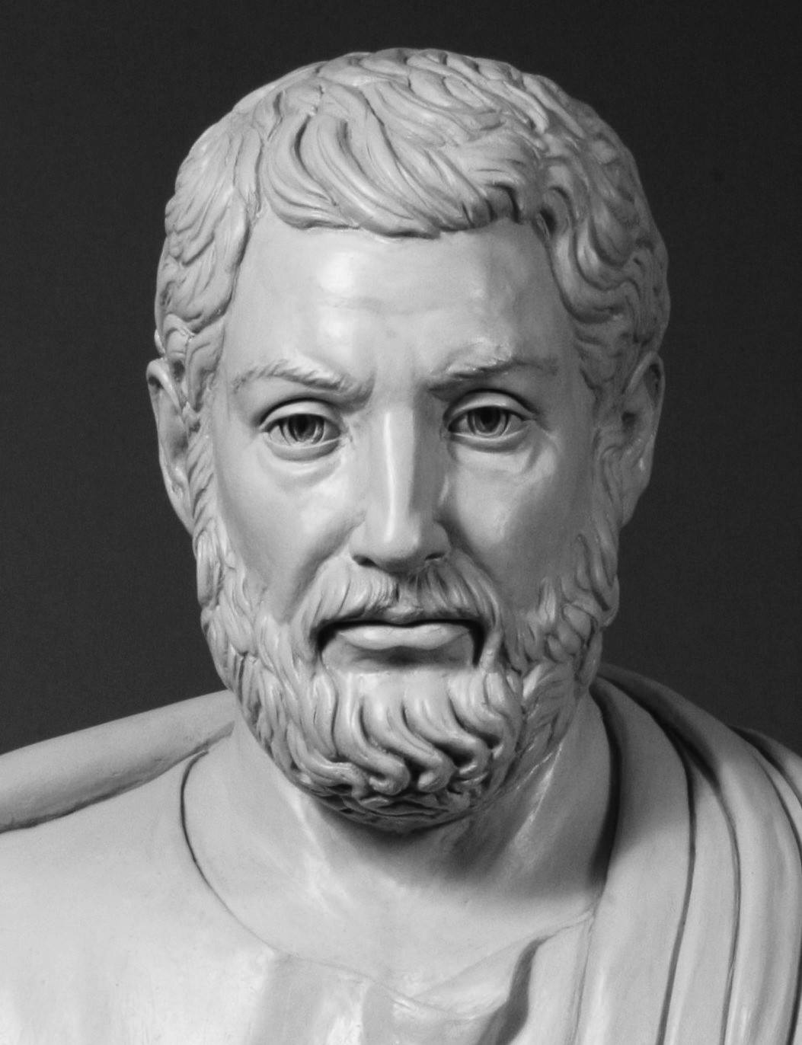
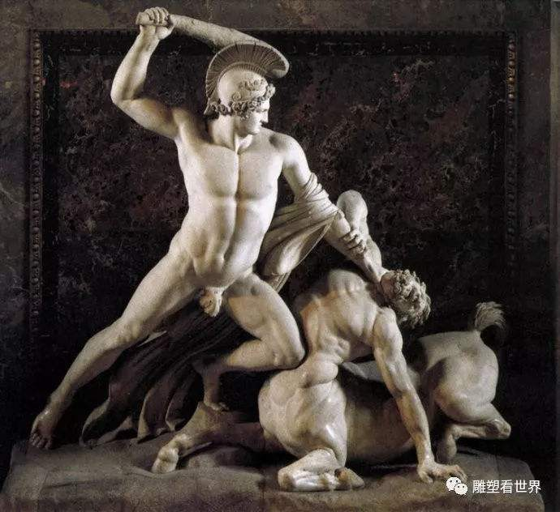
Solon and the Legend of Theseus

Slide 9
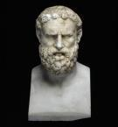
The Tyranny of Peisistratos （Πεισίστρατος，Peisistratos or Peisistratus，about 600～527 B.C.）
Peisistratus, also spelled Pisistratus, (born 6th century—died 527 BCE), tyrant of ancient Athens whose unification of Attica and consolidation and rapid improvement of Athens’s prosperity helped to make possible the city’s later preeminence in Greece.

Slide 10
Rise to Power
In 594 Peisistratus’s mother’s relative, the reformer Solon, had improved the economic position of the Athenian lower classes, but the Solonian reorganization of the constitution had not eliminated bitter aristocratic contentions for control of the archonship, the chief executive post. As Peisistratus reached manhood, the two major vying factions were called the Plain, led by Lycurgus, and the Coast, led by Megacles.

Slide 11
During a war with the city of Megara about 565, Peisistratus gained military fame by taking the Megarian harbour. He organized his own faction, named the Hillsmen, a group that included noble families from his own district, the eastern part of Attica, and also a very considerable part of the growing population of the city of Athens. At one point Peisistratus slashed himself and the mules of his chariot and made a dramatic entrance into the agora (marketplace) to show how his enemies had wounded him. The people voted him use of a bodyguard of citizens armed with clubs, with the aid of which he seized the Acropolis and held power briefly in 560/559. To increase his support he contracted a short-lived marriage with the daughter of Megacles and again acquired temporary power in Athens (probably 556–555), but Lycurgus and Megacles united to force him out.

Slide 12
For several years Peisistratus was an exile in northern Greece. He laid a solid base for his return, exploiting the silver and gold mines of Mount Pangaeum and gaining the support of conservatives in Thebes, Argos, Naxos, and elsewhere. In 546 he went to Eretria on the island of Euboea, with the force provided by his own funds and by his friends, and from this base invaded Attica. At Pallene, near Mount Hymettus, he launched a surprise attack on the Athenian army in the heat of midday, while his enemies were gambling or sleeping. After a complete victory, Peisistratus became master of Athens for the third time and remained in power until his death in 527. His sons Hippias and Hipparchus succeeded him.

Slide 13
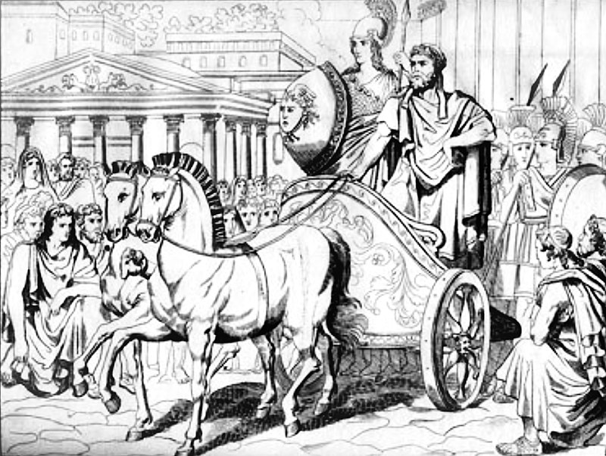
Peisistratos returned to Athens （安排自己与装扮成雅典娜女神的菲埃（Phye）一同进城，以此向众人暗示女神与他的特殊关系）

Slide 14
Tyrant of Athens
Peisistratus was master of Athens by the use of force, so in Greek terms he was a tyrannos. He maintained a mercenary bodyguard, composed in part of Scythian archers; he may have disarmed the citizens; and he certainly placed hostages from major families in safekeeping on the island of Naxos. Yet he preserved the constitutional forms of government and made them operate more efficiently. Some aristocrats cooperated and were permitted to hold the yearly post of archon; others went into exile. Once Peisistratus, accused of homicide, appeared before the court on the day of the trial, but his accuser dared not press the charge.

Slide 15
His internal policies appear to have been designed to increase the unity and majesty of the Athenian state. Since religion was closely interwoven with the structure of the Greek polis, or city-state, many of his steps were religious reforms. He brought the great shrine of Demeter at Eleusis under state control and constructed the first major Hall of the Mysteries (Telesterion) for the annual rites of initiation into the cult. Many local cults of Attica were either moved to the city or had branch shrines there. Artemis, for instance, continued to be worshiped at Brauron, but now there was also a shrine to Artemis on the Acropolis. Above all, Athena now became the main deity to be revered by all Athenian citizens. Peisistratus constructed an entry gate (later destroyed and replaced by Pericles’ Propylaea) on the Acropolis and perhaps built an old Parthenon under the temple that now stands on the crest of the Acropolis. Many sculptured fragments of limestone from Peisistratid buildings have been found on the Acropolis, and the foundations of a major, unfinished temple can still be seen.

Slide 16
Festivals and literature also flourished in Peisistratid times. The tyrant enhanced the glory of the Panathenaea, a yearly festival to Athena, by accentuating the Great Panathenaea (every four years) with athletic contests and prizes for bards who recited the Homeric epics. After the cult of Dionysus was placed under state sponsorship, prizes were awarded at the yearly Dionysia for the singing of dithyrambs and, from 534, for the performance of tragedies. Poets such as Anacreon lived at the court of Peisistratus and his sons, who also encouraged the collection of oracles and supported the famous soothsayer Onomacritus.

Slide 17
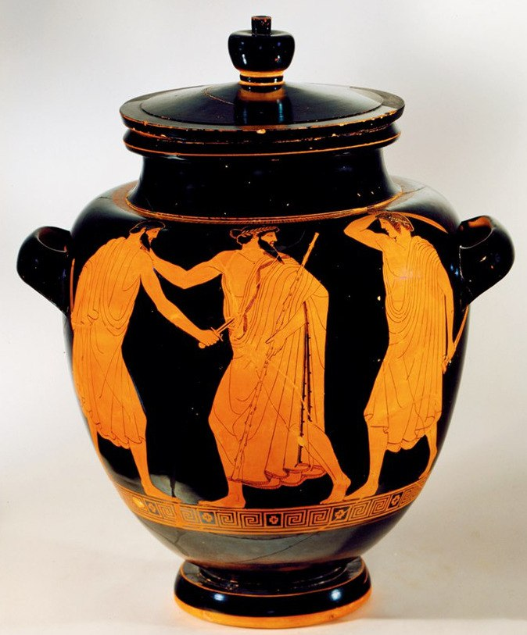
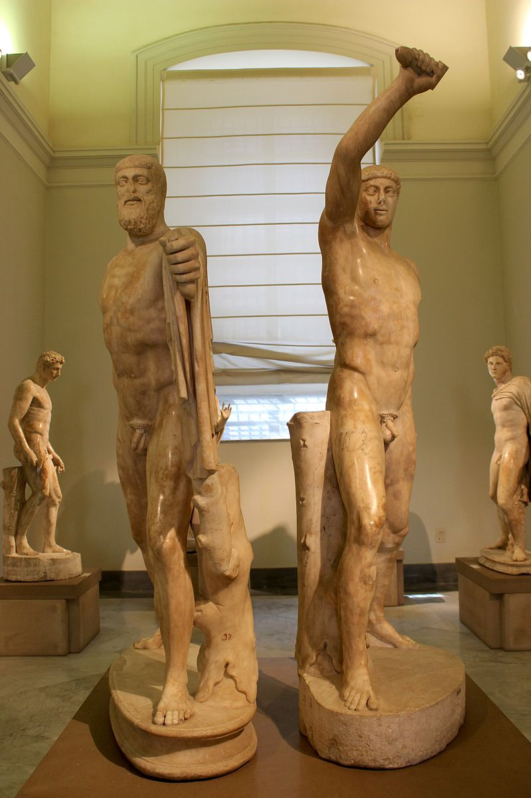
希庇阿斯（Hippias）,希帕库斯（Hipparchos）, 哈尔莫迪乌斯（Harmodius）与阿里斯托吉吞 （Aristogeiton）（其族来自腓尼基）

Slide 18
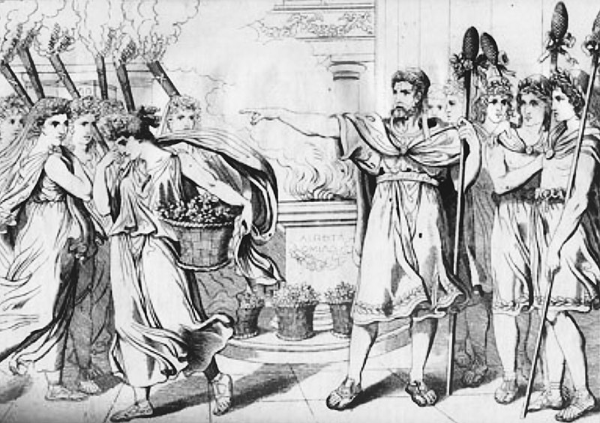
西帕尔库斯当众羞辱哈尔摩迪乌斯的姐姐Hipparchos insults Harmodius' sister in public

Slide 19
It could fairly be said that Peisistratos laid the foundations of future Athenian greatness. He was undoubtedly a man of great ability, and perhaps for that reason, his tyranny was generally accepted. But after he died, the rule of his sons, Hippias and Hipparchos, was resented. After a lovers’ quarrel with Hipparchos, two Athenians, Harmodius and Aristogeiton, decided to overthrow the ruling dynasty during the procession at the Panathenaic festival in 514 B.C. Hipparchos was stabbed, but the bodyguard of Ηippias managed to arrest the pair. Threatened, Ηίppias ονerreacted, killing many citizens he thought dangerous to him. The disinherited aristocrats met to eject him, but were defeated at Leipsydriοn near Mount Parnes, where many young nobles were killed. In 511-10, Ηippias fortified the hill of Munychia, overlooking Phaleron, where the warships were beached. The powerful Alkmeonid family then engineered his overthrow by calling upon the aid of King Kleomenes of Sparta. Wealthy patrons of Delphi, the Alkmeonids bribed the oracle to urge the Spartans to free Athens. Two attempts were necessary, but a Spartan army drove away the Thessalian cavalry which Ηippias had summoned to his aid, and besieged him on the Acropolis. When some of his children, hiding in the lower city, were caught by the besiegers, he surrendered and left under safe conduct.

Slide 20
Cleisthenes rose to power
The Spartan king then tried to interfere in the internal affairs of Athens in support of his ally Isagoras, in his rivalry with Kleisthenes, head of the powerful Alkmeonid clan, and expelled the latter, but when the Spartans withdrew, Kleisthenes placed himself at the head of the people against the return to power of the discredited aristocracy. He ostensibly ‘took the people into partnership’ and profoundly reformed the government of Athens in 507 B.C. These changes clearly had two purposes: to destroy once and for all the persistent and divisive loyalties to rival local leaders, and to create a situation of isonomia, or equality before the law, with an equal chance for everyone to participate in the government of the city. In this way he sought to defuse the divisions between rival families and between social classes which had so rent the life of the city before Peisistratos had imposed his tyranny, and at the same time remove the local bases of their power.

Slide 21
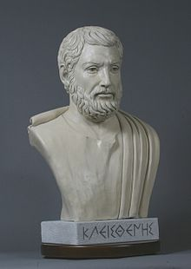
Cleisthenes Reform
Cleisthenes (/ˈklaɪsθɪˌniːz/; Greek: Κλεισθένης, Kleisthénēs; also Clisthenes or Kleisthenes,570 B.C.～？) Noble family background
(Alcmaeonid family)
An Greek archon (执政官) in the
period of Archaic Greece
the father of Athenian democracy

Slide 22
The background of the reform
Overthrowing Hippias
Competing with Isagoras
The return of Cleisthenes and
assuming leadership of Athens
Conflicts between different political factions in Athens after the reform of Solon: the plains, the mountains and the seashores.(conflicts between the common people and the people of nobility)
In 508 BC, Cleisthenes became the chief executive of Athens.

Slide 23
克里斯蒂尼改革：德莫（deme）
克里斯第尼重组了阿提卡地区的社会政治结构：德莫（通常是一个村镇）
公民全名：名+父姓+德莫
Aiskhulos（埃斯库罗斯） Euphorionos （游弗西诺斯的儿子）Eleusinieus （属于艾弗西斯德莫）
Cleisthenes changed Athenian democracy becuase he redefined what it was to be a citizen and so removed the influence of traditional clan groups. Now all citizens could participate in government, not just aristocrats.

Slide 24
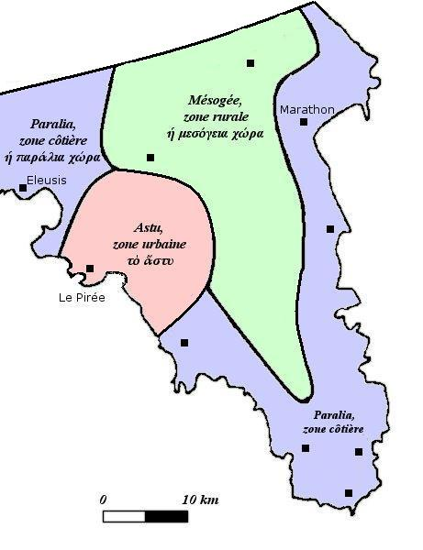
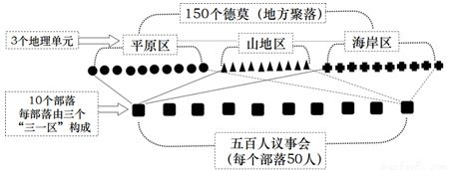
公民大会

Slide 25
The Reform of Cleisthenes
Disjoining the consanguine tribes;
from 4 tribes to 10 tribes
Purpose: to forestall strife between the traditional clans, which had led to the tyranny.
Contribution: tribes based on kinship were broken up which destroyed the foundation of the ruling of the noble and the control of Athenian politics by them.

Slide 26
2. 500-member Council (Boule) (400 members 500 members)
Formation: male citizens over 30; 50 from each tribe by drawing lots; one-year term.
Function: arranging the agenda of ecclesia including drafting probouleumata (议案); implementing the resolution of ecclesia(the most important one); diplomatic affairs(e.g. receiving envoys).
Characteristics: open to every male citizen over 30; equal opportunity (drawing lots)

Slide 27
3. the Board of ten strategi
(十将军委员会)
Formation: one general from each tribe, one-year term, one chief general
Role: the highest military organization; the power of military command; diplomatic power (signing treaties with other countries).
Contribution: weaken the power of curia; directly reporting to the ecclesia and leaving the legislative power to the public.

Slide 28
.4. “To advise according to the laws what was best for the people”
The Jury courts: 600 jurors in each one of ten courts;
The role of the courts: Judicial and procuratorial organs; to propose laws to the assembly;
The concept of ruling by law; the purpose of equal trial of Greek people.

Slide 29

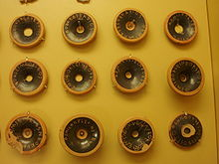
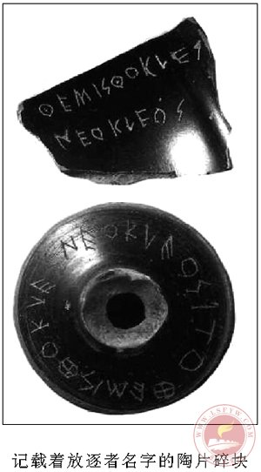
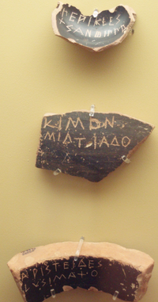
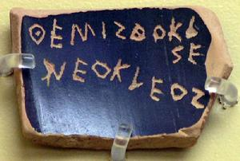
4. Ostracism
The working of ostracism
The evaluation of ostracism
Advantage: preventing the appearance of tyranny; the concept of ruling by people
Disadvantage: some talented and influential people may be influenced.

Slide 30
Contribution:(Father of Athenian democracy)
the failure of the noble and the collapse of the clan system (redistricting the electoral areas); consolidating the solidarity of Greek people (ostracism); the establishment of Greek democracy; Athens became the center of ancient Greece.

Slide 31
The Persian Threat (494-478)
At the end of the sixth century the very existence of Athens was threatened by a danger looming in the east. The expansion of the Persian Empire, the superpower of its time, had reached the Aegean shore and absorbed the Greek cities of Ionia. It was not to be expected that the fiercely independent spirit of the Greek city states could be crushed easily, even by such overwhelming force; and in 499 B.C. the Ionian city of Miletos led a concerted revolt against Persian rule. Answering their call for aid, the Athenians sent twenty ships to assist them. Although the rebels burned Sardis, the seat of the Persian satrap, the revolt was soon extinguished at the battle of Lade. In brutal reprisal, Miletos was destroyed, and its entire population massacred or enslaved. The strong identification of the Athenians with the Ionian cause was evident shortly afterwards, when Phrynichos put on his play The Capture of Miletos in Athens. Many in the audience burst into tears. Phrynichos was fined one thousand drachmas and his play banned.

Slide 32
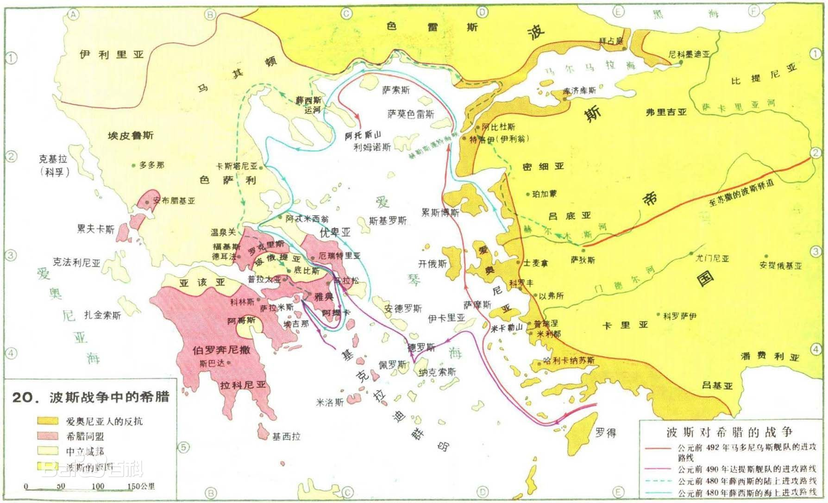

Slide 33
In 492 B.C. the Persian king, Darius, sent an expedition to conquer Thrace and Macedonia which was only withdrawn after much of his fleet was destroyed by a storm while rounding the peninsula of Athos.
The Aegean Sea, however, was no barrier to the spread of Persian power, for the islands of the archipelago, for the most part lying within sight of each other, invited further expansion. In June 490 Darius sent another force, which sailed from island to island across the Aegean receiving submission and tribute, and reducing any cities which resisted. This expedition was probably designed only to subdue the islands and then to reconnoitre the European shore; but the Athenians, conscious of the assistance they had rendered to rebel Miletos, expected Persian retribution. When, in September, having subdued Euboea, the Persians landed their forces in the Bay of Marathon, the Athenians feared the worst.

Slide 34
It is not known at that time whether the lower city was surrounded by a wall, but no unambiguous trace of one has yet been detected by the archaeologists. The defencelessness of the city has been used to explain why, with only some six hundred Plataean allies, the Athenian citizen army, under the command of the polemarch Kallimachos and the ten generals, numbering perhaps ten thousand men in all, marched out to Marathon.

Slide 35
The Athenian forces contented themselves with observing the Persians watering their horses at a lake on the north of the plain for several days Then when he saw an opportunity to strike, one of the generals, Miltiades, who had acquired experience of the fighting practices of the Persians in the Straits area, led a surprise attack against the invaders and defeated them.
Marathon remains one of the most important battles in world history. The Athenians lost only one hundred and ninety-two men, and their ‘victory’, how- ever insignificant it may have seemed to the Great King in distant Susa, filled the Athenians with a heady sense of their own potential, the results of which were to play a crucial role in the history of the long upward march of the human spirit. Α new self-confidence filled the people of Athens, and this spirit, however insecure its basis, was to have momentous consequences for the history of civilisation.

Slide 36
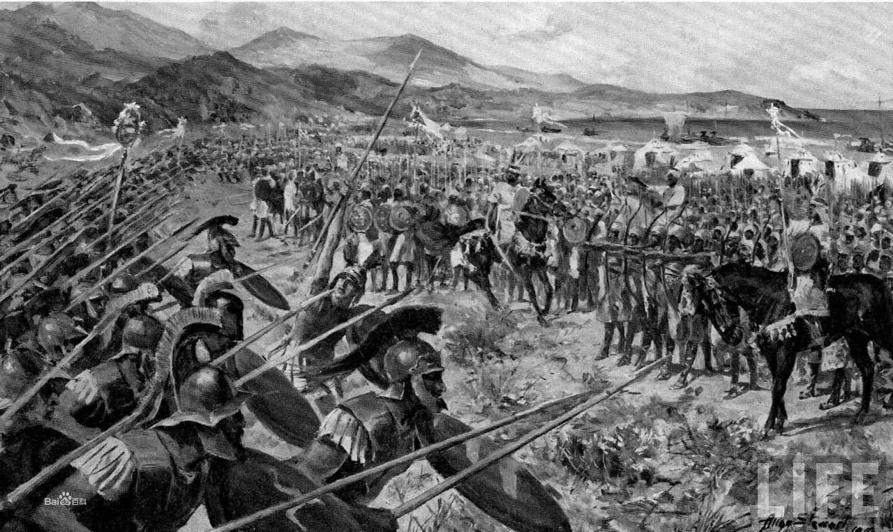
The Battle of Marathon

Slide 37
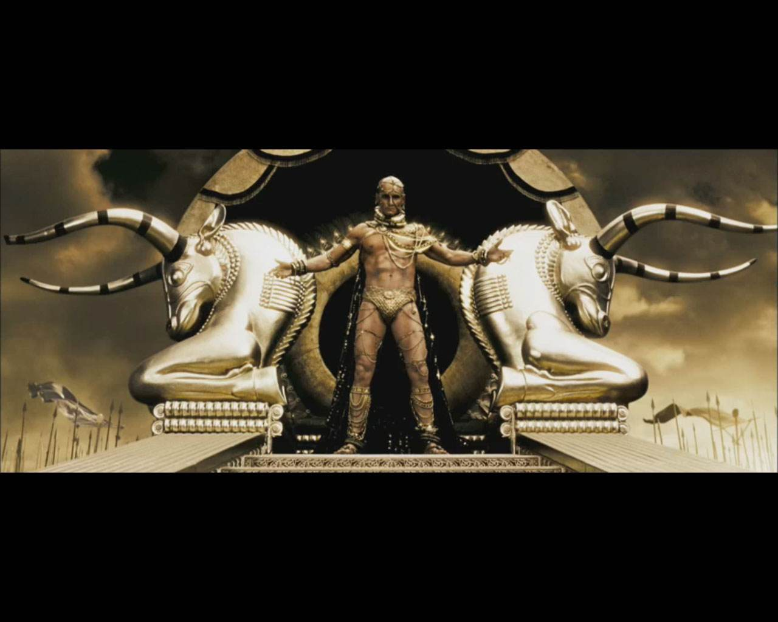
The Second War

Slide 38
When it became clear that King Xerxes was planning a campaign to subdue the whole of Thrace, Macedonia and the Greek peninsula, a meeting those states determined to resist met at the Isthmus. The Hellenic League was formed, and the Spartans were accepted as head of this alliance. All wars between its members, including that of Athens with Aegina, were promptly ended.

Slide 39
The attack, when it came in 480 B.C. was by both land and sea. 1η an attempt to prevent the Persian army entering the peninsula, a detachment was sent to block the Vale of Tempe. But when the leaders of this force found out that there were other ways into Greece, they returned to the Isthmus. Α second blocking attempt was made at the pass of Thermopylae. Most of those soldiers left when the Persians appeared; and the Spartan rear guard was surrounded and annihilated. As so often happens in wartime, this defeat was transformed by propaganda into a ‘moral victory’, but one that in no way held up the advance of the Persians. Despite the loss of many of his ships in a storm off Euboeia, and an indecisive engagement with Greek ships at Artemiston, the Thebans and some other states decided to side with the invaders, while the Peloponnesians built a wall across the Isthmus of Corinth, leaving Athens defenceless against overwhelming force.

Slide 40
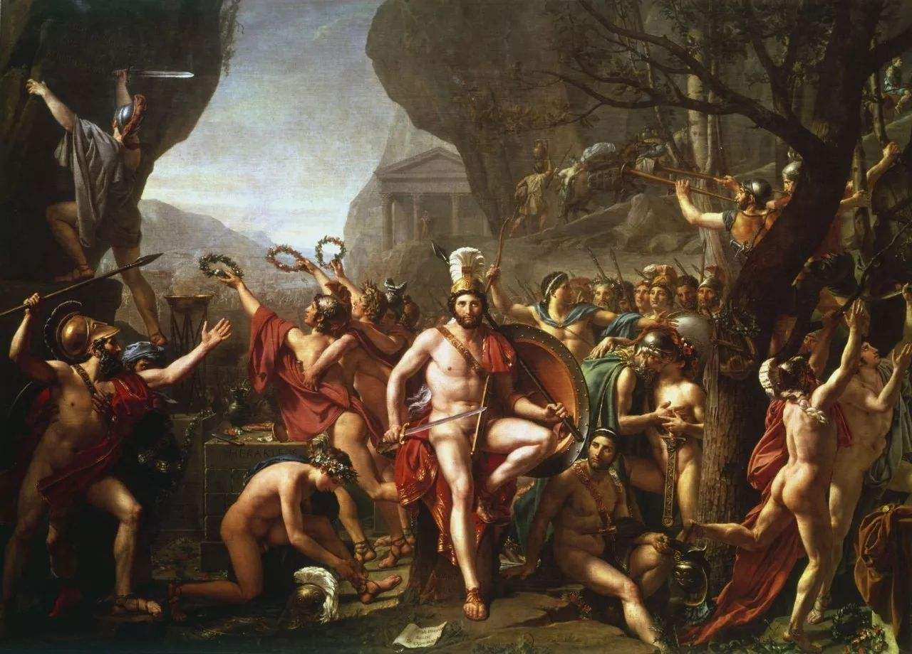
Thermopylae（温泉关战役）

Slide 41
The Delphic oracle had instructed the Athenians to rely on their ‘wooden walls’. Themistocles convinced the people that this was a cryptic reference to their ships, and the new navy was employed to evacuate the citizens to the nearby islands of Salamis and Aegina, and the peninsula of Troizen, while the fleet of the Hellenic League, having protected the operation, put into Salamis. Nine days after the engagement at Artemiston, the Persian fleet anchored in the Bay of Phaleron.
When Persians land forces arrived at Athens there were just a few people left behind, described as the Treasurers of the Temple of Athena and a mass of poor people, all barricaded on the acropolis. Because it was thought impregnable, the defenders had left the steep north side of the hill unguarded, and Persian soldiers managed to scale the cliff and the walls. The despairing defenders flung themselves from the battlements or fled into the temples, where they were slaughtered. The lower city and the temples on the acropolis were alike plundered and burned.

Slide 42
Themistokles had to employ all his cunning and duplicity to prevent the Greek fleet from either withdrawing to defend the Peloponnese, protected by its hastily built wall, and abandoning the rest of Greece, or simply breaking up, with the various contingents going their several ways. In secret communications with Xerxes he lured the Persian fleet into the narrow Bay of Salamis after convincing him that the Greek ships would otherwise escape his clutches, and provoked a battle in which the Persian fleet was decisively defeated. In this victory the new Athenian fleet played a key role, although it was agreed at the time that the first prize for valour in the battle really went to the Aeginetans.

Slide 43
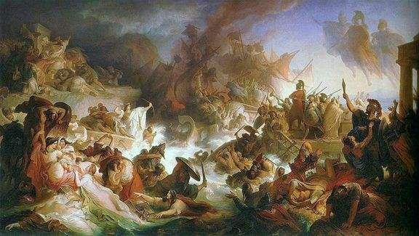
Salamis（萨拉米斯湾战役）

Slide 44
Disgusted, Xerxes went home, leaving his general Mardonius with part of his forces to winter in Greece and complete the subjugation of the region in the next spring. Mardonius, however, was defeated by the combined land forces of the Hellenic League at the battle of Plataea, and on the very same day, the Greek fleet, which had gone onto the offensive, defeated a Persian fleet at Cape Mycale, in Asia Minor. The Greeks of lonia promptly rose in revolt once more, and drove out the Persians, whose power in the Aegean was set to fade from this time onwards.

Slide 45
1
The isles of Greece, the Isles of Greece!
Where burning Sappho loved and sung,
Where grew the arts of war and peace,
Where Delos rose, and Phoebus sprung!
Eternal summer gilds them yet,
But all, except their sun, is set.
希腊群岛呵，希腊群岛！
你有过萨福歌唱爱情，
你有过隆盛的武功文教，
太阳神从你的提洛岛诞生！
长夏的阳光灿烂如金——
除了太阳，一切都沉沦！

Slide 46
2
The Scian and the Teian muse,
The hero's harp, the lover's lute,
Have found the fame your shores refuse;
Their place of birth alone is mute
To sounds which echo further west
Than your sires' 'Islands of the Blest.'
开俄斯歌手，忒俄斯诗人，
英雄的竖琴，恋人的琵琶，
在你的境内没没无闻，
诗人的故土悄然喑哑——
他们在西方的名声远扬，
远过你祖先的乐岛仙乡。

Slide 47
3
The mountains look on Marathon —
And Marathon looks on the sea;
And musing there an hour alone,
I dream'd that Greece might still be free;
For standing on the Persians' grave,
I could not deem myself a slave.
巍巍群山望着马拉松，
马拉松望着海波万里，
我沉思半晌，在我的梦幻中
希腊还像是自由的土地；
脚下踩的是波斯人坟墓，
我怎能相信我是个亡国奴！

Slide 48
4
A king sate on the rocky brow
Which looks o'er sea-born Salamis;
And ships, by thousands, lay below,
And men in nations; — all were his!
He counted them at break of day —
And when the sun set where were they?
有一位国王坐在山顶，
萨拉米海盗展现在脚下，
成千的战舰，各国的兵丁，
在下面排开——全归他统辖！
天亮时，他还在数去数来——
太阳落水时，他们安在？

Slide 49
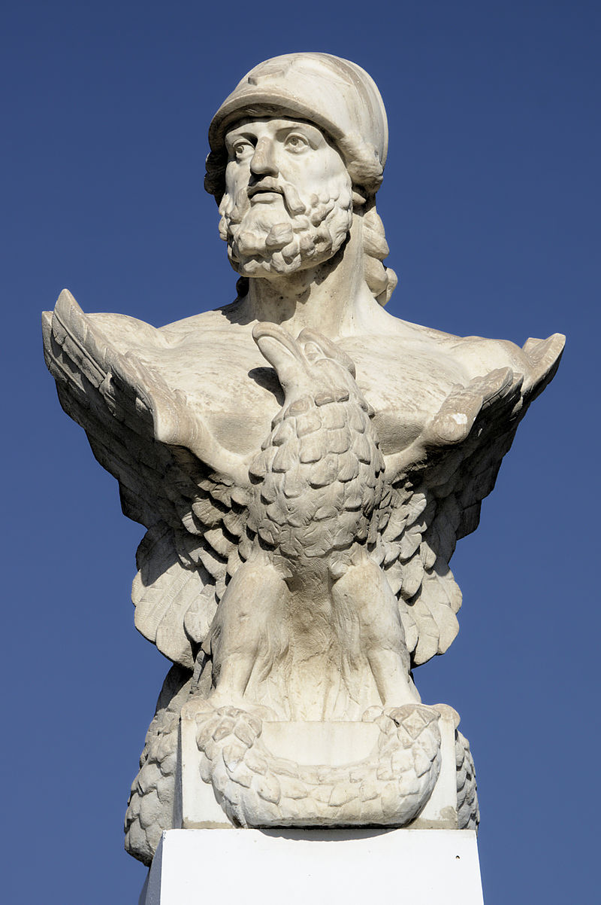
The reforms of Ephialtes （Ephialtes about 500 B.C. ―461B.C.）
That phase of foreign policy has to be somehow associated with internal change at Athens, the so-called Ephialtic reforms. In 462, together with the young Pericles, the Athenian statesman Ephialtes pushed through the decisive phase of the reforms, namely an assault on the powers of the Areopagus.

Slide 50
These powers, except for a residual jurisdiction over homicide and some religious offenses, and perhaps a formal “guardianship of the laws,” were redistributed among the Council of Five Hundred and the popular law courts. This is, in essence, the very bald and unhelpful account of the main source, the Constitution of Athens; there must have been more to it, but the problem is to know how much more. Probably the Areopagus ceased to hear crimes against the state, and such cases were transferred to the popular courts.

Slide 51
The rejection of Cimon
Some of these changes were perhaps already in the air when the Spartans dismissed Cimon and his Athenians at Ithome. Cimon’s absence seems to have given Ephialtes and Pericles their chance: the main Areopagus reform was passed at this time, and in 461 Cimon was ostracized. This rejection of Cimon, however, was a personal matter: he should not be seen as a “conservative” opponent of a reform that gave more power to the people and especially to the thetic class, which manned the fleet. For one thing, Cimon’s victory at the Battle of the Eurymedon River was primarily a naval victory; for another, it was the Sparta-loving Cimon and his hoplites who were dismissed by the Spartans from Ithome for their subversive tendencies.

Slide 52
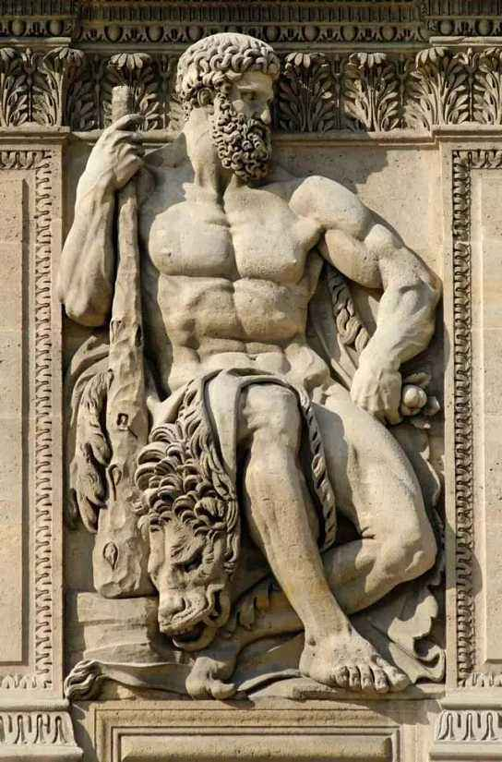
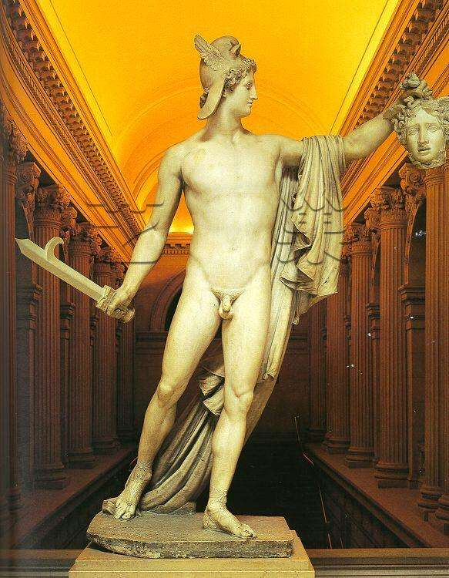
The Ally of Athens：From Sparta to Argos

Slide 53
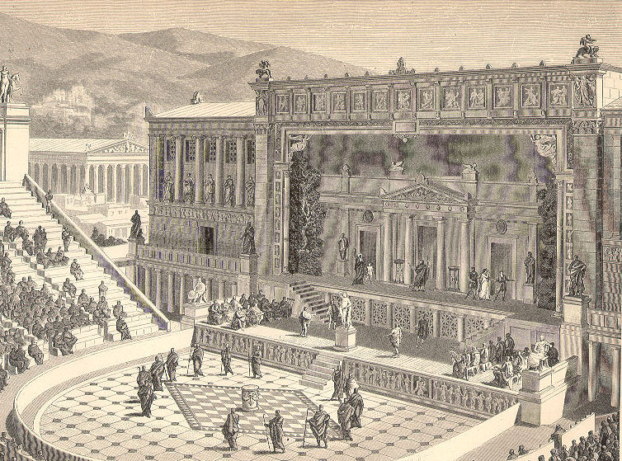
The roots of Greek Tragedies: festivals for the gods, chiefly Dionysus, the god of wine

Slide 54
The exact origins of tragedy (tragōida) are debated amongst scholars. Some have linked the rise of the genre, which began in Athens, to the earlier art form, the lyrical performance of epic poetry. Others suggest a strong link with the rituals performed in the worship of Dionysos such as the sacrifice of goats - a song ritual called trag-ōdia - and the wearing of masks. Indeed, Dionysos became known as the god of theatre and perhaps there is another connection - the drinking rites which resulted in the worshipper losing full control of their emotions and in effect becoming another person, much as actors (hupokritai) hope to do when performing. The music and dance of Dionysiac ritual was most evident in the role of the chorus and the music provided by an aulos player, but rhythmic elements were also preserved in the use of first, trochaic tetrameter and then iambic trimeter in the delivery of the spoken words.

Slide 55
Performed in an open-air theatre (theatron) such as that of Dionysos in Athens and seemingly open to all of the male populace (the presence of women is contested), the plot of a tragedy was almost always inspired by episodes from Greek mythology, which we must remember were often a part of Greek religion. As a consequence of this serious subject matter, which often dealt with moral right and wrongs, no violence was permitted on the stage and the death of a character had to be heard from offstage and not seen. Similarly, at least in the early stages of the genre, the poet could not make comments or political statements through the play, and the more direct treatment of contemporary events had to wait for the arrival of the less austere and conventional genre, Greek comedy.

Slide 56
The early tragedies had only one actor who would perform in costume and wear a mask, allowing him the presumption of impersonating a god. Here we can see perhaps the link to earlier religious ritual where proceedings might have been carried out by a priest. Later, the actor would often speak to the leader of the chorus, a group of up to 15 actors who sang and danced but did not speak. This innovation is credited to Thespis in c. 520 BCE. The actor also changed costumes during the performance (using a small tent behind the stage, the skēne, which would later develop into a monumental façade) and so break the play into distinct episodes. Phrynichos is credited with the idea of splitting the chorus into different groups to represent men, women, elders, etc. (although all actors on the stage were in fact male). Eventually, three actors were permitted on stage - a limitation which allowed for equality between poets in competition. However, a play could have as many non-speaking performers as required, so, no doubt, plays with greater financial backing could put on a more spectacular production with finer costumes and sets. Finally, Agathon is credited with adding musical interludes unconnected with the story itself.

Slide 57
Tragedy in Competition
The most famous competition for the performance of tragedy was as part of the spring festival of Dionysos Eleuthereus or the City Dionysia in Athens, but there were many others. Those plays which sought to be performed in the competitions of a religious festival (agōn) had to go through an audition process judged by the archon. Only those deemed worthy of the festival would be given the financial backing necessary to procure a costly chorus and rehearsal time. The archonwould also nominate the three chorēgoi, the citizens who would each be expected to fund the chorus for one of the chosen plays (the state paid the poet and lead actors). The plays of the three selected poets were judged on the day by a panel and the prize for the winner of such competitions, besides honour and prestige, was often a bronze tripod cauldron. From 449 BCE there were also prizes for the leading actors (prōtagōnistēs).

Slide 58
The Three Tragedians
Aristotle: the art form of Greek tragedy grew under the influence of Aeschylus, matured in the hands of Sophocles then began its precipitous decline with Euripides.

Slide 59
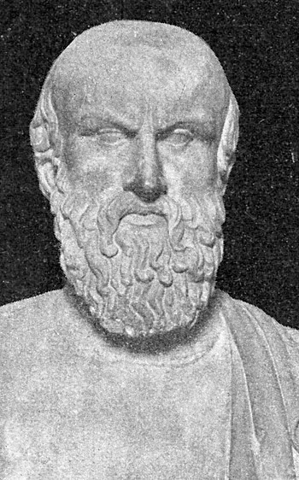
Aeschylus Αἰσχύλος, Aiskhulos; c. 525/524 – c. 456/455 BC
seven of estimated seventy to ninety plays of him survived
Trilogies:
the Oresteia
Seven against Thebes being the final play in an Oedipus trilogy,
The Suppliants and Prometheus Bound each being the first play in a Danaid trilogy and Prometheus trilogy

Slide 60
The first of the great tragedian poets was Aeschylus (c. 525 - c. 456 BCE). Innovative, he added a second actor for minor parts and by including more dialogue into his plays, he squeezed more drama from the age-old stories so familiar to his audience. As plays were submitted for competition in groups of four (three tragedies and a satyr-play), Aeschylus often carried on a theme between plays, creating sequels. One such trilogy is Agamemnon, The Libation Bearers (or Cheoephori), and The Furies (or Eumenides) known collectively as the Oresteia. Aeschylus is said to have described his work, consisting of at least 70 plays of which six or seven survive, as 'morsels from the feast of Homer'

Slide 61
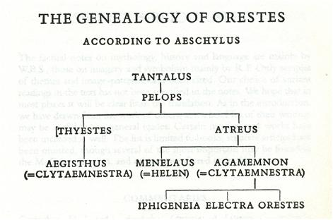

Slide 62
The Oresteia
Agamemnon
Aeschylus begins in Greece describing the return of king Agamemnon from his victory in the Trojan War, from the perspective of the towns people (the Chorus) and his wife, Clytemnestra. However, dark foreshadowings build to the death of the king at the hands of his wife, who was angry at his sacrifice of their daughter Iphigenia, killed so the Gods would stop a storm hindering the Greek fleet in the war. She was also unhappy at his keeping of the Trojan prophetess Cassandra as a concubine. Cassandra foretells of the murder of Agamemnon, and of herself, to the assembled townsfolk, who are horrified. She then enters the palace knowing that she cannot avoid her fate. The ending of the play includes a prediction of the return of Orestes, son of Agamemnon, who will seek to avenge his father.

Slide 63
The Curse of Atreus’ Family ἀ-, "no" and τρέω, "tremble", "fearless",

Slide 64
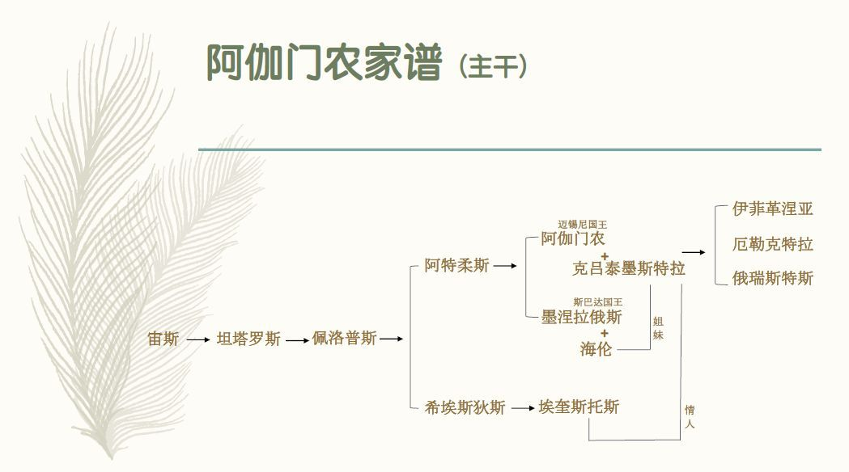

Slide 65
King Tantalus was beloved by the gods, who came to dine with him at his home on earth. But out of secretly held spite against the immortals, Tantalus murdered his son and fed the Olympians cooked human flesh. But the gods were not fooled. They brought the boy back to life and punished Tantalus by placing him in Tartarus, the Underworld. There he stands in a pool of water that evaporates when he leans down to take a drink. Above him is a vine blooming with fruit that the wind moves out of reach whenever he reaches up to take a bite. Tantalus’ punishment gave us the English word “tantalizing.”

Slide 66
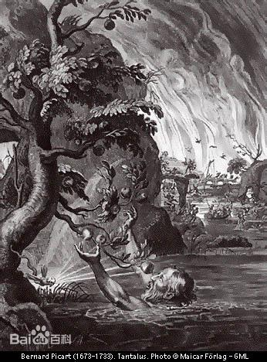
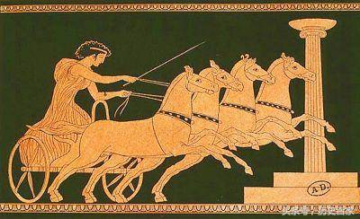
Tantalus and Pelops

Slide 67
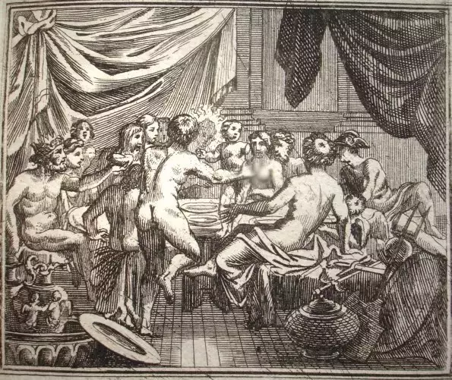
The rebirth of Pelops
Pelops was the father and older member of the Royal House of the Atreids, ruling the area of Mycenae, Argos and Tiryns in the Peloponnese Peninsula.

Slide 68
A curse, said to have been pronounced by Myrtilus, plagued the descendants of Pelops. His sons Alcathous, Atreus, and Thyestes set upon a bloody course with the murder of their stepbrother Chrysippus, the son of Pelops’s union with a nymph. After the crime the three brothers fled their native city of Pisa; Alcathous went to Megara, and Atreus and Thyestes stopped at Mycenae, where Atreus became king. But Thyestes either contested Atreus’s right to rule or seduced Atreus’s wife, Aërope, and thus was driven from Mycenae. To avenge himself, Thyestes sent Pleisthenes (Atreus’s son, whom Thyestes had brought up as his own and who does not figure in every version of the story), to kill Atreus, but the boy was himself slain, unrecognized by his father.

Slide 69
When Atreus learned the identity of the boy, he recalled Thyestes to Mycenae in apparent reconciliation. At a banquet Atreus served Thyestes the flesh of Thyestes’ own son (or sons), whom Atreus had slain in vengeance for the death of Pleisthenes. Thyestes fled in horror to Sicyon; there he impregnated his own daughter Pelopia in the hope of raising one more son to avenge himself. Atreus subsequently married Pelopia, and she afterward bore Aegisthus. Atreus believed this child to be his own, but Aegisthus was in fact the son of Thyestes.

Slide 70
Agamemnon And Menelaus
The two sons of Atreus left for Sikyon after their father died. Agamemnon got married to Clytemnestra, who murdered her husband Tantalus, the third son of Thyestes. Agamemnon became the king of Mycenae(Argos), while his brother Menelaus got married to the beautiful Helen, sister of Clytemnestra.

Slide 71
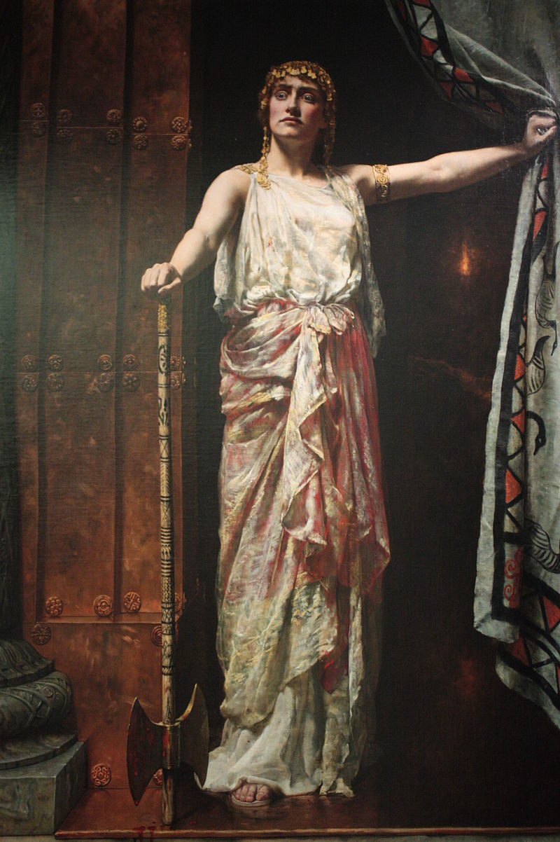
Clytaemnestra
Daughter of Tyndareus, sister of Helen, and wife of Agamemnon. Clytaemnestra and her sister Helen married the brothers Agamemnon and Menelaus, respectively. Clytaemnestra controls the city of Argos while her husband is fighting at Troy for ten years, seething with anger about the death of her eldest daughter Iphigenia. Bold, aggressive, and cunning, she behaves like a man, dominating those around her, including the Chorus and even her own husband, when she convinces him to walk across the red carpet upon his return. With the help of Aegisthus, she plotted the bloody murder of her husband when he returns from the war, in order to avenge Iphigenia's death and punish him for his infidelity to her by making Cassandra his lover. She states afterwards that she and Aegisthus will now rule Argos, for her young son Orestes, also the next heir to the throne, has been sent away into exile.

Slide 72
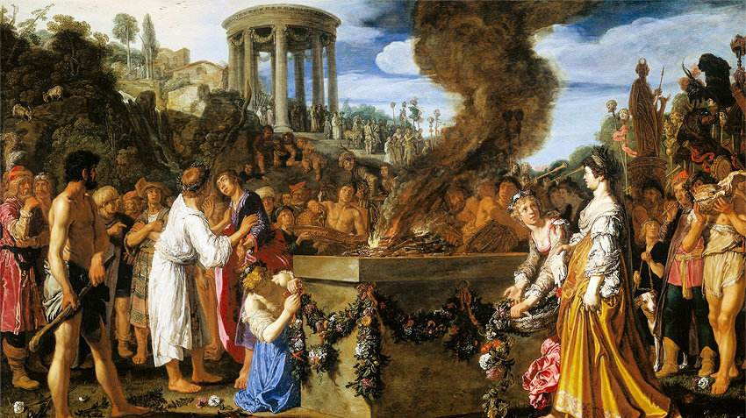
The Agamemnon

Slide 73
The Watchman
I pray the gods to quit me of my toils, To close the watch I keep, this livelong year; For as a watch-dog lying, not at rest, Propped on one arm, upon the palace-roof Of Atreus' race, too long, too well I know The starry conclave of the midnight sky, Too well, the splendours of the firmament, The lords of light, whose kingly aspect shows-What time they set or climb the sky in turn-The year's divisions, bringing frost or fire. And now, as ever, am I set to mark when shall stream up the glow of signal-flame, The bale-fire bright, and tell its Trojan tale-Troy town is ta'en: such issue holds in hope She in whose woman's breast beats heart of man.
我祈求众神解除我长年守望的辛苦，一年来我像一头狗似的，支着两肘趴在阿特瑞代（Atreidai）的屋顶上；这样，我认识了夜里聚会的群星，认识了那些闪烁的君王，他们在天空很显眼，给人们带来夏季和冬天。今夜里，我照常观望信号火炬——那火光将从特洛亚带来消息，报告那都城的陷落——因为一个有男人气魄，盼望胜利的女人是这样命令我的。

Slide 74
The Watchman
Thus upon mine unrestful couch I lie, Bathed with the dews of night, unvisited By dreams-ah me!-for in the place of sleep Stands Fear as my familiar, and repels The soft repose that would mine eyelids seal.
And if at whiles, for the lost balm of sleep, I medicine my soul with melody Of trill or song-anon to tears I turn, Wailing the woe that broods upon this home, Not now by honour guided as of old-
当我躺在夜里不让我入睡的，给露水打湿了的这只榻上的时候——迷梦也不来拜望，因为恐惧代替睡眠站在旁边，使我不能紧闭着眼睛睡一睡——当我想唱唱歌，哼哼调子，挤一点歌汁来医治我的瞌睡病的时候，我就为这个家的不幸而悲叹，这个家料理得不像从前那样好了。

Slide 75
But now at last fair fall the welcome hour That sets me free, whenever the thick night glow With beacon-fire of hope deferred no more. All hail! A beacon-light is seen reddening the distant sky. Fire of the night, that brings my spirit day, Shedding on Argos light, and dance, and song,
Greetings to fortune, hail!
但愿此刻有火光在黑暗中出现，报告好消息，使我侥幸的摆脱这辛苦！
欢迎啊，火光，你在黑夜里放出白天的光亮，作为发动许多阿耳戈斯歌舞队的信号，庆祝这幸运！

Slide 76
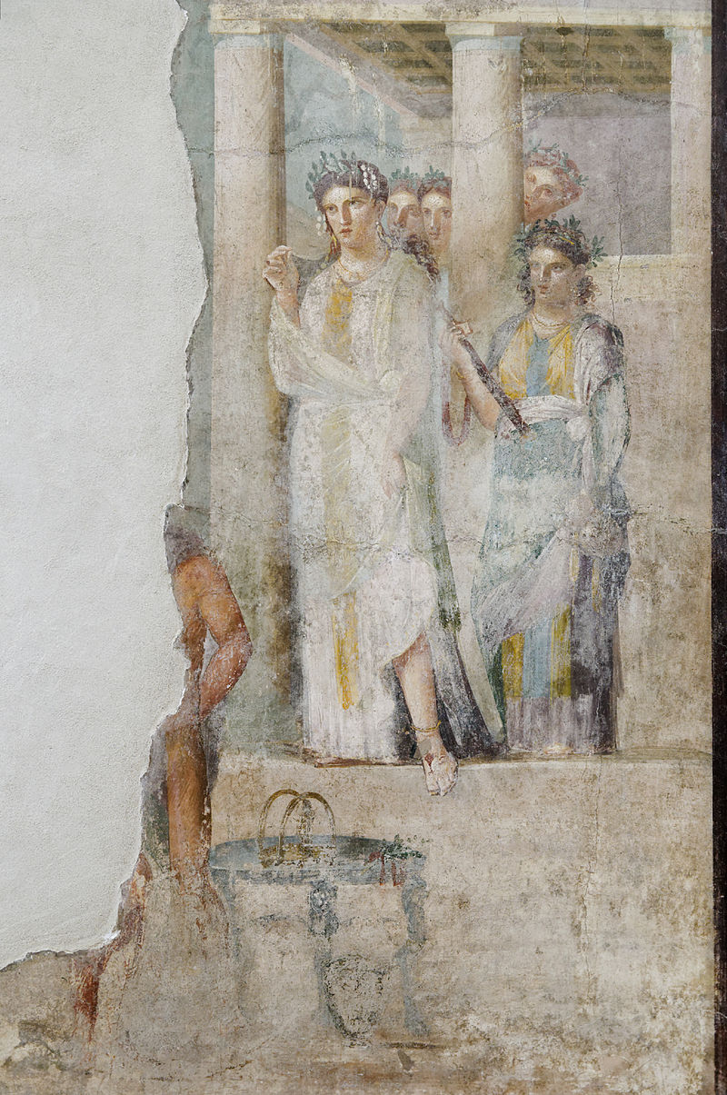
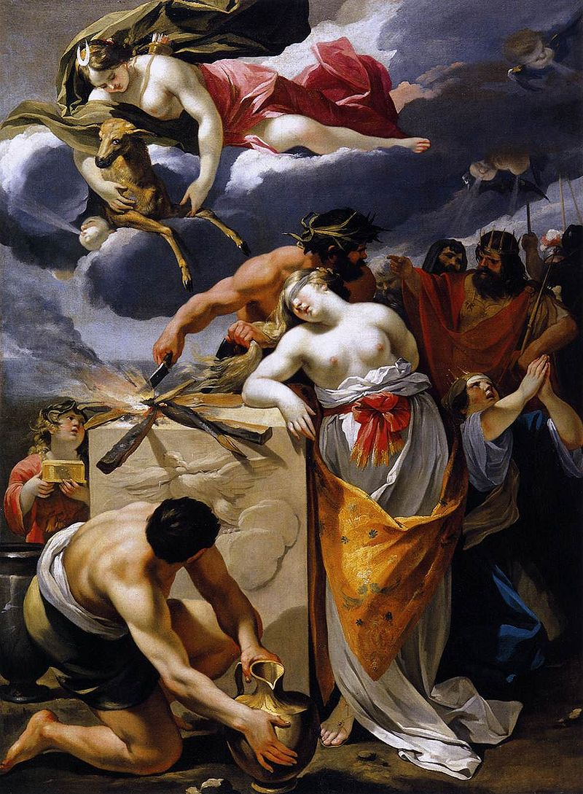
伊菲革涅亚的献祭 The Sacrifice of Iphigenia

Slide 77
In order for the Greek fleet to sail away to Troy, Agamemnon sacrifices Iphigenia, the Eldest daughter of Agamemnon and Clytaemnestra, to the goddess Artemis, much to his wife's utter disgust and total outrage. He had lured her to the place of sacrifice, called Aulis, by telling his wife that Iphigenia was going to be married to the Greek warrior Achilles. Clytaemnestra uses similar deceptions to murder her husband ten years later in order to avenge her beloved daughter's death.

Slide 78
Aegisthus
Son of Thyestes; cousin of Agamemnon; lover of Clytaemnestra. Aegisthus helps Clytaemnestra to plot Agammenon's murder, although he does not commit the murder himself. Because a woman did the deed for him, the Chorus, considers him to be a coward and calls him a woman. Aegisthus avenges the murders of his siblings and the exile of his father, Thyestes, at the jealous hands of Atreus, by helping to kill Atreus' son, Agamemnon.

Slide 79
The Text
'Tis Zeus alone who shows the perfect way Of knowledge: He hath ruled, Men shall learn wisdom, by affliction schooled. In visions of the night, like dropping rain, Descend the many memories of pain Before the spirit's sight: through tears and dole Comes wisdom o'er the unwilling soul- A boon, I wot, of all Divinity, That holds its sacred throne in strength, above the sky!
（第三曲首节）是宙斯引导凡人走上智慧的道路，因为他立了这条有效的法则：智慧自苦难中得来。回想起从前的灾难，痛苦会在梦寐中，一滴滴滴在心上，甚至一个顽固的人也会从此小心谨慎。这就是坐在那庄严的艄公凳上的神强行赠送的恩惠。

Slide 80
And rife with ill delay From northern Strymon blew the thwarting blast-Mother of famine fell, That holds men wandering still Far from the haven where they fain would be!-And pitiless did waste Each ship and cable, rotting on the sea, And, doubling with delay each weary hour, Withered with hope deferred th' Achaeans' warlike flower.
（第四曲首节）从斯特律蒙吹来的暴风引起了饥饿，有害的闲暇，危险的停泊，使兵士游荡，船只和缆索受亏损，时间拖得太久，阿耳戈斯的花朵便从此凋谢枯萎，

Slide 81
But when, for bitter storm, a deadlier relief, And heavier with ill to either chief, Pleading the ire of Artemis, the seer avowed, The two Atreidae smote their sceptres on the plain, And, striving hard, could not their tears restrain!
先知最后向两位领袖大声的说出另一个比猛烈的风暴更难忍受的挽救方法，并且提起阿耳忒弥斯的名字，急得阿特瑞代用王杖击地，禁不住流泪。

Slide 82
And then the elder monarch spake aloud-Ill lot were mine, to disobey! And ill, to smite my child, my household's love and pride! To stain with virgin blood a father's hands, and slay My daughter, by the altar's side! Twixt woe and woe I dwell-I dare not like a recreant fly, And leave the league of ships, and fail each true ally; For rightfully they crave, with eager fiery mind,
T he virgin's blood, shed forth to lull the adverse wind-God send the deed be well!
（第四曲次节）那年长的国王说道:“若要不服从，命运自然是苦；但是，若要杀了我的女儿，我家里可爱的孩子，在祭坛旁边使父亲的手沾染杀献闺女流出来的血，那也是苦啊！哪一种办法没有痛苦呢？我又怎能辜负联军，抛弃舰队呢？这不行，因为急切的要求杀献，流闺女的血来平息风暴，也是合情合理的啊！但愿—切如意。

Slide 83
Thus on his neck he took Fate's hard compelling yoke; Then, in the counter-gale of will abhorred, accursed, To recklessness his shifting spirit veered-Alas! that Frenzy, first of ills and worst, With evil craft men's souls to sin hath ever stirred!
And so he steeled his heart-ah, well-a-day- Aiding a war for one false woman's sake, His child to slay, And with her spilt blood make An offering, to speed the ships upon their way!
（第五曲首节）他受了强迫戴上轭，他的心就改变了，不洁净，不虔诚，不畏神明，他从此转了念头，胆大妄为。凡人往往受“迷惑”那坏东西怂恿，她出坏主意，是祸害的根源。因此他忍心作他女儿的杀献者，为了援助那场为一个女人的缘故而进行报复的战争，为舰队而举行祭祀。

Slide 84
Lusting for war, the bloody arbiters Closed heart and ears, and would nor hear nor heed The girl-voice plead, Pity me, Father! nor her prayers, Nor tender, virgin years. So, when the chant of sacrifice was done, Her father bade the youthful priestly train Raise her, like some poor kid, above the altar-stone, From where amid her robes she lay Sunk all in swoon away-Bade them, as with the bit that mutely tames the steed, Her fair lips' speech refrain, Lest she should speak a curse on Atreus' home and seed,
（第五曲次节）她的祈求，她呼唤“父亲”的声音，她的处女时代的生命，都不曾被那些好战的将领所重视。她父亲作完祷告，叫执事人趁她诚心诚意跪在他袍子前面的时候，把她当一只小羊举起来按在祭坛上，并且管住她的美丽的嘴，不让她诅咒他的家。

Slide 85
So, trailing on the earth her robe of saffron dye, With one last piteous dart from her beseeching eye. Those that should smite she smote Fair, silent, as a pictur'd form, but fain To plead, Is all forgot? How oft those halls of old, Wherein my sire high feast did hold, Rang to the virginal soft strain, When I, a stainless child, Sang from pure lips and undefiled, Sang of my sire, and all His honoured life, and how on him should fall Heaven's highest gift and gain!
（第六曲首节）那要靠暴力和辔头的禁止发声的力量。她的紫色袖子垂向地面，眼睛向着每个献祭的人射出乞怜的目光，像图画里的人物那样显眼，她想呼唤他们的名字——她曾经多少次在她父亲宴客的厅堂里唱过歌，那闺女用她的贞洁的声昔，在第三次奠酒的时候，很亲热的回敬她父亲的快乐的祷告声。

Slide 86
The Victory
From Ida's top Hephaestus, lord of fire, Sent forth his sign; and on, and ever on, Beacon to beacon sped the courier-flame. From Ida to the crag, that Hermes loves, Of Lemnos; thence unto the steep sublime Of Athos, throne of Zeus, the broad blaze flared. Thence, raised aloft to shoot across the sea,
克吕泰墨斯特拉 赫淮斯托斯，他从伊得山发出灿烂的火光。火的快差把信号火光—段段的传来；伊得首先把它送到楞诺斯岛上的赫耳墨斯悬崖上，然后阿托斯半岛上的宙斯峰从那里把巨大的火炬接到手；那奔跑的火炬使劲跳跃，跳过海，欢乐的前进……

Slide 87
The moving light, rejoicing in its strength, Sped from the pyre of pine, and urged its way, In golden glory, like some strange new sun, Onward, and reached Macistus' watching heights. There, with no dull delay nor heedless sleep, The watcher sped the tidings on in turn, Until the guard upon Messapius' peak Saw the far flame gleam on Euripus' tide, And from the high-piled heap of withered furze Lit the new sign and bade the message on.
那松脂火炬像太阳一样把金色的光芒运到马喀斯托斯山上的望楼前。那山峰没有昏睡，没有拖延时间，没有疏忽信差的职务；那信号火光经过欧里波斯海峡上空，远远把消息递给墨萨庇翁山上的守望人。他们也依次点起了火焰——烧的是—堆枯草——把消息往前传递。

Slide 88
Then the strong light, far-flown and yet undimmed, Shot thro' the sky above Asopus' plain, Bright as the moon, and on Cithaeron's crag Aroused another watch of flying fire. And there the sentinels no whit disowned, But sent redoubled on, the hest of flame Swift shot the light, above Gorgopis' bay, To Aegiplanctus' mount, and bade the peak Fail not the onward ordinance of fire.
那火炬依然旺盛，一点也没有暗淡，像明月—样眺过了阿索波斯平原，直达喀泰戎悬崖，在那里催促这信号火光的另一个接力者。那里的守望人不但没有拒绝远处传来的火光，反而点燃了—朵比命令所规定的更大的火焰，那火光在戈耳戈眼似的湖水上面一闪而过，到达山羊游玩的山上，劝那里的守望人不可漠视生火的命令。

Slide 89
And like a long beard streaming in the wind, Full-fed with fuel, roared and rose the blaze, And onward flaring, gleamed above the cape, Beneath which shimmers the Saronic bay, And thence leapt light unto Arachne's peak, The mountain watch that looks upon our town. Thence to th' Atreides' roof-in lineage fair, A bright posterity of Ida's fire. So sped from stage to stage, fulfilled in turn, Flame after flame, along the course ordained, And lo! the last to speed upon its way Sights the end first, and glows unto the goal. And Troy is ta'en, and by this sign my lord Tells me the tale, and ye have learned my word.
他们大卖力气，点燃了火，送出一丛大火须，那火须飘过那俯瞰萨洛尼科斯海峡的海角，依然在燃烧，跟着就下降，到达了阿剌克奈翁山峰——靠近我们的都城的守望站，然后从那里落到阿特瑞代的尾顶上，这光亮是伊得山上的火焰的几孙。这就是我安排的火炬竞赛——一个个依次跑完，那最先跑和最后跑的人是胜利者。这就是我告诉你的证据和信号——我丈夫从特洛亚传递给我的。

Slide 90
I spare your longer tale- The king himself anon shall tell me all.
Remains to think what honour best may greet My lord, the majesty of Argos, home. What day beams fairer on a woman's eyes Than this, whereon she flings the portal wide, To hail her lord, heaven-shielded, home from war?
（向传令官）此刻何必要你向我详细报告？我自会从国王本人那里从头听到尾。但是我得赶快准备以最好的仪式迎接我的可尊敬的丈夫归来。在妻子眼中还有什么阳光此今天的更可爱呢，当天神使她丈夫从战争里平安回来，她为他启开大门的时候？

Slide 91
This to my husband, that he tarry not, But turn the city's longing into joy! Yea, let him come, and coming may he find A wife no other than he left her, true And faithful as a watch-dog to his home, His foemen's foe, in all her duties leal, Trusty to keep for ten long years unmarred The store whereon he set his master-seal.
把这话带给我丈夫。请他，城邦爱戴的君王，快快回来！愿他回来，在家里发现他的妻子很忠实，和分别时候的人儿一样，他家看门的狗，对他怀好意，对那些仇视他的人却怀敌意，在其它各方面，也是一样，在这长久的时间内，她连封印都没有破坏一个。

Slide 92
The Red Carpet
A red carpet that Clyaemnestra insists that Agamemnon walk upon when he victoriously returns from Troy. At first the man is resistant because he doesn't want to be arrogant by claiming that he alone is responsible for the Greek victory, rather than it being because of the gods. However, Clytaemnestra is very persistent and Agamemnon agrees at last to take off his shoes and walk barefoot upon the carpet proudly, as if he himself were a god. This act seals his fate, having lost any godly protection and making him an easy victim to his wife's jealousy.

Slide 93
The couple
Sweet lord, step forth, Step from thy car, I pray-nay, not on earth Plant the proud foot, O king, that trod down Troy! Women! why tarry ye, whose task it is To spread your monarch's path with tapestry? Swift, swift, with purple strew his passage fair, That justice lead him to a home, at last, He scarcely looked to see. The attendant women spread the tapestry. For what remains, Zeal unsubdued by sleep shall nerve my hand to work as right and as the gods command.
克吕泰墨斯特拉：现在，亲爱的，快下车来！但是，主上啊，你这只曾经踏平伊利翁的脚不可踩在地上。婢女们，你们奉命来把花毡铺在路上，为什么拖延时间呢？快拿紫色毡子铺一条路，让正义之神引他进入他意想不到的家？至于其余的事，我的没有昏睡的心，在神的帮助下，会把它们正当的安排好，正像命运所注定的那样。
[众侍女铺花毡。]

Slide 94
Daughter of Leda, watcher o'er my home, Thy greeting well befits mine absence long, For late and hardly has it reached its end. Know, that the praise which honour bids us crave, Must come from others' lips, not from our own: See too that not in fashion feminine Thou make a warrior's pathway delicate; Not unto me, as to some Eastern lord, Bowing thyself to earth, make homage loud. Strew not this purple that shall make each step An arrogance; such pomp beseems the gods, Not me. A mortal man to set his foot on these rich dyes? I hold such pride in fear,
阿伽门农 勒达的后裔，我家的保护人，你的话和我们别离的时间正相当；因为你把它拖得太长了。但是适当的称赞——那颂辞应当由别人嘴里念出来。此外，不要把我当一个女人来娇养，不要把我当一个东方的君王，趴在地下张着嘴向我欢呼，不要在路上铺上绒毡，引起嫉妒心。

Slide 95
And bid thee honour me as man, not god. Fear not-such footcloths and all gauds apart, Loud from the trump of Fame my name is blown; Best gift of heaven it is, in glory's hour, To think thereon with soberness: and thou-Bethink thee of the adage, Call none blest Till peaceful death have crowned a life of weal. 'Tis said: I fain would fare unvexed by fear.
只有对天神我们才应当用这样的仪式表示敬意，一个凡人在美丽的花毡上行走，在我看来，未免可怕。鞋擦和花毡，两个名称音不同。谦虚是神赐的最大的礼物；要等到一个人在可爱的幸运中结束了他的生命之后，我们才可以说他是有福的。我已经说过，我要怎样行动才不至于有所畏惧。

Slide 96
CLYTEMNESTRA
Nay, but unsay it-thwart not thou my will!
AGAMEMNON
Know, I have said, and will not mar my word.
CLYTEMNESTRA
Was it fear made this meekness to the gods?
AGAMEMNON
If cause be cause, 'tis mine for this resolve.
CLYTEMNESTRA
What, think'st thou, in thy place had Priam done?
AGAMEMNON
He surely would have walked on broidered robes.
克吕泰墨斯特拉 现在我问你一句话，把你的意见老老实实告诉我。
阿伽门农 我的意见，你可以相信，不会有假。
克吕泰墨斯特拉 你在可怕的紧急关头，会不会向神许愿，要作这件事？
阿伽门农 只要有祭司规定这仪式。
克吕泰墨斯特拉 普里阿摩斯如果这样打赢了，你猜他会怎么办？
阿伽门农 我猜他一定在花毡上行走。

Slide 97
CLYTEMNESTRA
Then fear not thou the voice of human blame.
AGAMEMNON
Yet mighty is the murmur ofa crowd.
CLYTEMNESTRA
Shrink not from envy, appanage of bliss.
AGAMEMNON
War is not woman's part, nor war of words.
CLYTEMNESTRA
Yet happy victors well may yield therein.
AGAMEMNON
Dost crave for triumph in this petty strife?
克吕泰墨斯特拉 那么你就不必害怕人们的谴责。
阿伽门农 可是人民的声音是强有力的。
克吕泰墨斯特拉 但是不被人嫉妒，就没人羡慕。
阿伽门农 一个女人别想争斗！
克吕泰墨斯特拉 但是一个幸运的胜利者也应当让一手。
阿伽门农 什么？你是这样重视这场争吵的胜利吗？

Slide 98
CLYTEMNESTRA
Yield; of thy grace permit me to prevail!
AGAMEMNON
Then, if thou wilt, let some one stoop to loose swiftly these sandals, slaves beneath my foot; And stepping thus upon the sea‘s rich dye, I pray, let none among the gods look down with jealous eye on me-reluctant all, To trample thus and mar a thing of price, Wasting the wealth of garments silver-worth…
克吕泰墨斯特拉 让步吧！你自愿放弃，也就算你胜利。
阿伽门农 也罢，如果你一定要这样，就叫人把我的靴子，在脚下伺候我的高底鞋，快快脱了，当我在神的紫色料子上面行走的时候，愿嫉妒的眼光不至于从高处射到我身上！我的强烈的敬畏之心阻止我踩坏我的家珍，糟蹋我的财产——银子换来的织品……

Slide 99
Enough hereof: and, for the stranger maid, Lead her within, but gently: God on high looks graciously on him whom triumph's hour has made not pitiless. None willingly wear the slave's yoke-and she, the prize and flower of all we won, comes hither in my train, gift of the army to its chief and lord.-Now, since in this my will bows down to thine, I will pass in on purples to my home.
这件事说得很够了。至于这个客人，请你好心好意引她进屋；对一个厚道的主人，神总是自天上仁慈的关照。没有人情愿戴上奴隶的轭，她是从许多战利品中选出来的花朵，军队的犒赏，跟着我前来的。现在，既然非听你的话不可，我就踏着紫颜色进宫。

Slide 100
Cassandra
Sister of Paris; daughter of Priam, King of Troy. Given powers of prophesy by the god Apollo but also cursed because she refused to make love to him, Cassandra is condemned to foretell the future, but no one believes her predictions. After Troy is sacked, Agamemnon brings her back to Argos with him, much to the upset of his wife Clytaemnestra. Although Cassandra tries to warn the Chorus about Clytaemnestra's murder plot, these old men do not believe her. The brave Cassandra then willingly enters the palace knowing that she will die there, as her body is left stabbed and bloodied at Agamemnon's side. She asks Apollo that whoever it is that will avenge Agammenon's death, let that person remember her and avenge her death as well.

Slide 101
CHORUS singing strophe1
Wherefore for ever on the wings of fear hovers a vision drear before my boding heart? a strain, unbidden and unwelcome, thrills mine ear, oracular of pain. Not as of old upon my bosom's throne sits Confidence, to spurn such fears, like dreams we know not to discern. Old, old and grey long since the time has grown, which saw the linked cables moor the fleet, when erst it came to Ilion's sandy shore;
歌 队（第一曲首节）这恐惧为什么在我这预知祸福的心上不住的飘来飘去？我没有被邀请，不要报酬，为什么要歌唱未来的事？为什么不把它赶走，像赶走一个难以解释的梦一样，让那可信赖的勇气坐在我心里的宝座上？时间已经过去很久了，自从水师开往伊利翁的时候，沙子随着船尾缆索的收回而飞扬以来。

Slide 102
antistrophe 1
And now mine eyes and not another's see their safe return. Yet none the less in me the inner spirit sings a boding song, Self-prompted, sings the Furies' strain-And seeks, and seeks in vain, to hope and to be strong! Ah! to some end of Fate, unseen, unguessed, are these wild throbbings of my heart and breast-Yea, of some doom they tell-Each pulse, a knell. Lief, lief I were, that all to unfulfilment's hidden realm might fall.
（第一曲次节）我如今亲眼看见他们凯旋，我自己是个见证；但是我的心自己学会了唱报仇神的不须弦琴伴奏的哀歌，一点也感觉不到来自希望的可贵的勇气。我的内心不是在乱说——这颗心啊，它正在那旋到底的旋涡里面绕着那预知有报应的思想转来转去。但愿这个猜想不正确，不会成为事实！

Slide 103
The cruel maiden
CLYTEMNESTRA
Get thee within thou too, Cassandra, go! For Zeus to thee in gracious mercy grants to share the sprinklings of the lustral bowl, Beside the altar of his guardianship, slave among many slaves. What, haughty still? Step from the car; Alcmena's son, 'tis said, Was sold perforce and bore the yoke of old.
克吕泰墨斯特拉 你也进去——我是说你，卡珊德拉——既然宙斯大发慈悲，使你能在我家里同许多奴隶一起站在家神的祭坛旁边，分得一份净水。快下车来，别太骄傲了！据说连阿尔克墨涅的儿子也曾卖身为奴，吃过奴隶吃的大麦粑。

Slide 104
Ay, hard it is, but, if such fate befall, 'Tis a fair chance to serve within a home of ancient wealth and power. An upstart lord, To whom wealth's harvest came beyond his hope, is as a lion to his slaves, in all exceeding fierce, immoderate in sway. Pass in: thou hearest what our ways will be.
一个人如果被这种命运逼迫，那么落在—个继承祖业的主人手里，是一件很值得感谢的事。有些人一本突然收万利，可是他们对奴隶在各方面都很残忍，而且很严厉…………你已经从我这里知道了我们怎样待奴隶。

Slide 105
Agamemnon the victim
CLYTEMNESTRA Truce to this bootless waiting here without! I will not stay: beside the central shrine the victims stand, prepared for knife and fire - Offerings from hearts beyond all hope made glad. Thou-if thou reckest aught of my command, 'Twere well done soon: but if thy sense be shut from these my words, let thy barbarian hand fulfil by gesture the default of speech.
克吕泰墨斯特拉 我没有功夫在大门外逗留；因为羊牲正站在那中央的神坛前，等候着燔祭。你如果愿意照我的话作去，就不要耽误时间；但是，如果你不懂希腊话，不明白我的意思，你就用外方人的手势代替语言答复我。

Slide 106
CLYTEMNESTRA
'Tis madness and the rule of mind distraught, since she beheld her city sink in fire, And hither comes, nor brooks the bit, until in foam and blood her wrath be champed away. See ye to her; unqueenly 'tis for me, unheeded thus to cast away my words.
克吕泰墨斯特拉 她准是疯了，胡思乱想，她从那刚陷落的都城来到这里，还不懂得怎样忍受这嚼铁的羁束，在她还没有流血，使她的火气随着泡沫一起吐出之前。我不愿意多说话，免得有伤我的尊严。

Slide 107
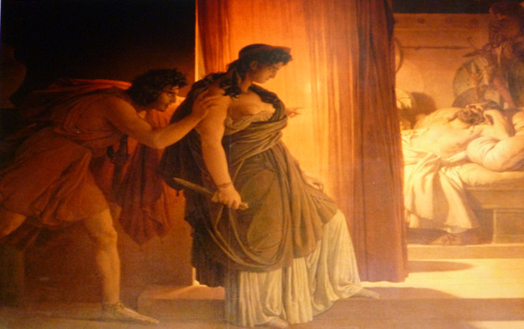
The murder of Agamemnon

Slide 108
[后景壁转开，壁后有一个活动台，阿伽门农的尸体躺在台上的澡盆里，上面盖着一件袍子，卡瑞德拉的尸体躺在那旁边，克吕泰墨斯特拉站在台上。

Slide 109
Ho, ye who heard me speak so long and oft the glozing word that led me to my will--Hear how I shrink not to unsay it all! How else should one who willeth to requite Evil for evil to an enemy Disguised as friend, weave the mesh straitly round him, not to be overleaped, a net of doom? This is the sum and issue of old strife, of me deep-pondered and at length fulfilled.
克吕泰墨斯特拉 刚才我说了许多话来适应场合，现在说相反的话也不会使我感觉羞耻，否则一个向伪装朋友的仇敌报复的人，怎能把死亡的罗网挂得高高的，不让他们越网而逃？这场决战经过我长期考虑，终于进行了，这是旧日的争吵的结果。

Slide 110
我还是站在我杀人的地点上，我的目的已经达到了。我是这样作的——我不否认——使他无法逃避他的命运；我拿一张没有漏洞的撒网，像网鱼一样把他罩住，这原是一件致命的宝贵的长袍。我刺了他两剑；他哼了两声，手脚就软了。我趁他倒下的则候，又找补第三剑，作为献给地下的宙斯，死者的保护神的还愿礼物。这么着，他就躺在那里，断了气，他喷出一股汹涌的血，一阵血雨的黑点便落到我身上，我的畅快不亚于麦苗承受天降的甘雨，正当出穗的时节。
All is avowed, and as I smote I stand with foot set firm upon a finished thing! I turn not to denial: thus I wrought so that he could nor flee nor ward his doom. Even as the trammel hems the scaly shoal, I trapped him with inextricable toils, the ill abundance of a baffling robe; Then smote him, once, again--and at each wound he cried aloud, then as in death relaxed each limb and sank to earth; and as he lay, Once more I smote him, with the last third blow, sacred to Hades, saviour of the dead. And thus he fell, and as he passed away, spirit with body chafed; each dying breath flung from his breast swift bubbling jets of gore, and the dark sprinklings of the rain of blood fell upon me; and I was fain to feel that dew-- not sweeter is the rain of heaven to corn land, when the green sheath teems with grain.

Slide 111
CLYTEMNESTRA
Ye hold me as a woman, weak of will, and strive to sway me: but my heart is stout, nor fears to speak its uttermost to you, albeit ye know its message. Praise or blame, even as ye list,-- I reck not of your words. Lo! at my feet lies Agamemnon slain, my husband once-- and him this hand of mine, a right contriver, fashioned for his death. Behold the deed!
克吕泰墨斯特拉 你们把我当一个愚蠢的女人，向我挑战，可是我鼓起勇气告诉你们，虽然你们已经知道了——不管你们愿意称赞我还是责备我，反正是—样——这就是阿伽门农，我的丈夫，我这只右手，这公正的技师，使他成了—具尸首。事实就是如此。

Slide 112
CHORUS chanting
Woman, what deadly birth, What venomed essence of the earth or dark distilment of the wave, to thee such passion gave, nerving thine hand to set upon thy brow this burning crown, the curses of thy land? Our king by thee cut off, hewn down! Go forth-- they cry-- accursed and forlorn, to hate and scorn!
歌 队（哀歌序曲首节）啊，女人，你尝了地上长的什么毒草，或是喝了那流动的海水上面浮出的什么毒物，以致发疯，惹起公共的诅咒？你把他抛弃了，砍掉了，你自己也将被放逐，为市民所痛恨。

Slide 113
CLYTEMNESTRA
O ye just men, who speak my sentence now, The city's hate, the ban of all my realm! Ye had no voice of old to launch such doom on him, my husband, when he held as light my daughter's life as that of sheep or goat, one victim from the thronging fleecy fold! Yea, slew in sacrifice his child and mine, the well-loved issue of my travail-pangs, to lull and lay the gales that blew from Thrace.
克吕泰墨斯特拉 你现在判处我被放逐出国，叫我遭受市民的憎恨和公共的诅咒，可是当初你全然不反对这家伙，那时候他满不在乎，像杀死一大群多毛的羊中一头牲畜一样，把他自己的孩子，我在阵痛中生的最可爱的女儿，杀来祭献，使特剌刻吹来的暴风平静下来。

Slide 114
That deed of his, I say, that stain and shame, had rightly been atoned by banishment; But ye. who then were dumb, are stern to judge this deed of mine that doth afront your ears. Storm out your threats, yet knowing this for sooth, that I am ready, if your hand prevail as mine now doth, to bow beneath your sway: If God say nay, it shall be yours to learn by chastisement a late humility.
难道你不应当把他放逐出境，惩罚他这罪恶？你现在审判我的行为，倒是个严厉的陪审员！可是我告诉你，你这样恐吓我的时候，要知道我也是同样准备好了的，只有用武力制服我的人才能管辖我，但是，如果神促成相反的结果，那么你将受到一个教训，虽然晚了一点，也该小心谨慎。

Slide 115
CHORUS chanting
Bold is thy craft, and proud thy confidence, thy vaunting loud; thy soul, that chose a murd'ress' fate, is all with blood elate--Maddened to know the blood not yet avenged, the damn'ed spot Crimson upon thy brow. But Fate prepares for thee thy lot--Smitten as thou didst smite, without a friend, to meet thine end!
歌 队（次节）你野心勃勃，言语傲慢，你的心由于杀人流血而疯狂了，看你的眼睛清清楚楚充满了血。你一定被朋友们所抛弃，打了人耍挨打，受到报复。（序曲完）

Slide 116
CLYTEMNESTRA
Hear then the sanction of the oath I swear--By the great vengeance for my murdered child, by Ate, by the Fury unto whom this man lies sacrificed by hand of mine, I do not look to tread the hall of Fear, While in this hearth and home of mine there burns The light of love--Aegisthus--as of old loyal, a stalwart shield of confidence--
克吕泰墨斯特拉 这个，我的誓言的神圣的力量，你也听听，我凭那位曾为我的孩子主持正义的神，凭阿忒和报仇神——我曾把这家伙杀来祭她们——起誓，我的向往不至于误入恐惧之门，只要我灶上的火是由埃癸斯托斯点燃的——他对我一向忠实，有了他，就有了使我们壮胆的大盾牌……

Slide 117
CLYTEMNESTRA Chanting
I deem not that the death he died had overmuch of shame:
for this was he who did provide foul wrong unto his house and name: His daughter, blossom of my womb, He gave unto a deadly doom, Iphigenia, child of tears! And as he wrought, even so he fares. Nor be his vaunt too loud in hell; For by the sword his sin he wrought, And by the sword himself is brought among the dead to dwell.
克吕泰墨斯特拉 我既不认为他是含辱而死……因为他不是偷偷的毁了他的家，而是公开的杀死了我怀孕给他生的孩子，我所哀悼的伊菲革涅亚。他自作自受，罪有应得，所以他不得在冥府里夸口；因为他死于剑下，偿还了他所欠的血债。

Slide 118
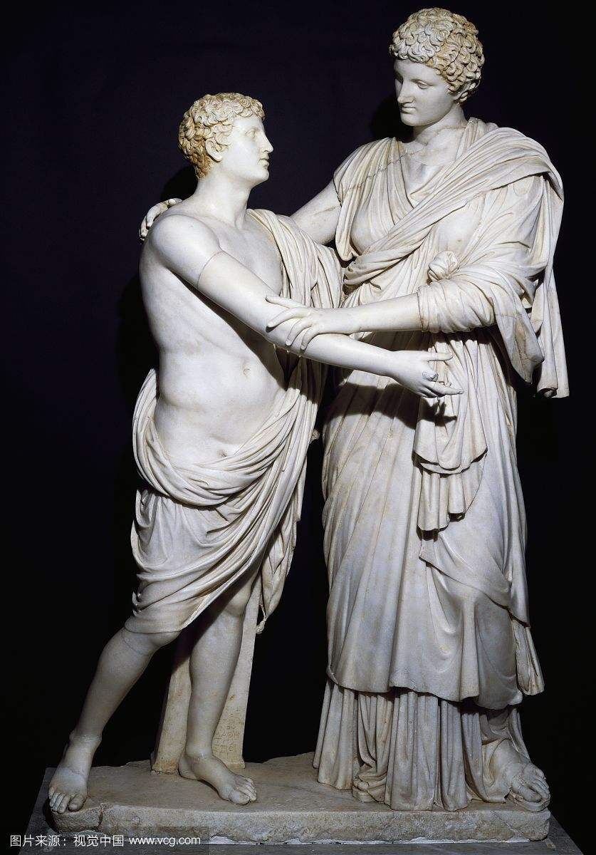
The Libation Bearers
The Libation Bearers continues the tale, opening with Orestes's arrival at Agamemnon's tomb. At the tomb, Electra meets Orestes, who has returned from exile in Phocis, and they plan revenge upon Clytemnestra and her lover Aegisthus. Clytemnestra's account of a nightmare in which she gives birth to a snake is recounted by the chorus; and this leads her to order Electra, her daughter, to pour libations on Agamemnon's tomb (with the assistance of libation bearers) in hope of making amends. Orestes enters the palace pretending to bear news of his own death, and when Clytemnestra calls in Aegisthus to share in the news, Orestes kills them both. Orestes is then beset by the Furies, who avenge the murders of kin in Greek mythology.

Slide 119
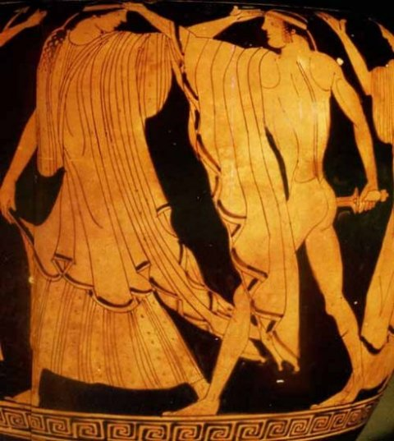
The revenge of Orestes
The double revenge
1.for the father
2.for Argos

Slide 120
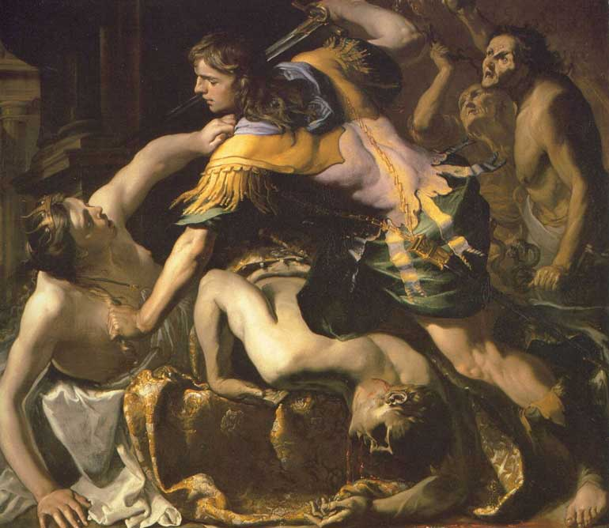
The Death of Clytemnestra

Slide 121
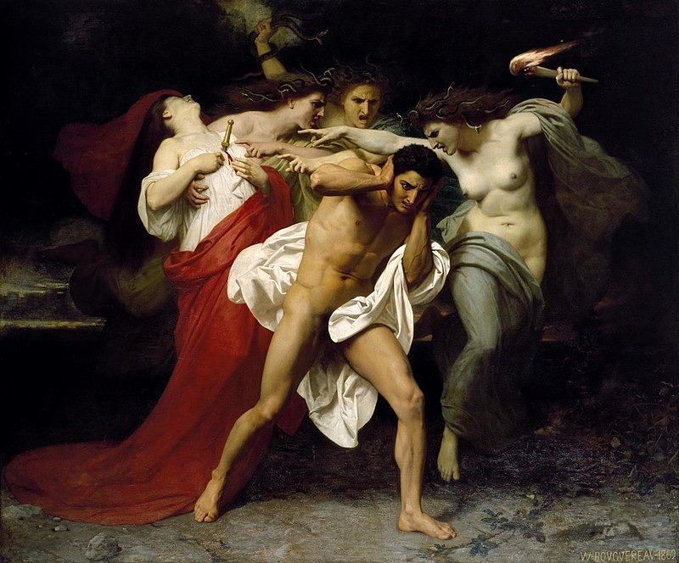
Eumenides (Erinyes盖亚受孕于乌拉诺斯之血而生)

Slide 122
The Eumenides
The priestess of Apollo discovers Orestes as a suppliant in the inner shrine of the god at Delphi, and fronting him the Erinyes of his mother, a band of fearsome creatures who, wearied with the pursuit of the fugitive, have fallen on sleep. Under promise of his support, Apollo bids Orestes flee to Athens, where he shall submit his case to judgment and be released from his sufferings. The ghost of Clytaemestra rises to upbraid the sleeping Erinyes because of their neglect, whereby she is dishonoured among the other dead. Awakened by her taunts, they revile Apollo for that he has given sanctuary to a polluted man whom they rightly pursue by reason of their office—to take vengeance on all who shed kindred blood.

Slide 123
The scene shifts to Athens, whither his pursuers have tracked their prey. Orestes, clasping the ancient image of Pallas, implores her protection on the plea that the blood upon his hands has long since been washed away by sacred rites and that his presence has worked harm to none who have given him shelter. The Erinyes chant a hymn to bind the soul of their victim with its maddening spell. In answer to Orestes’ call, the goddess appears and with the consent of the Erinyes undertakes to judge the case, not by herself alone but with the assistance of a chosen number of her best citizens who are to constitute the jury.

Slide 124
The trial opens with Apollo present as advocate of his suppliant and as representative of Zeus, whose commands he has merely to set forth in all his oracles. Orestes, he declares, slew his mother by his express behest. The accused confesses to the deed but urges in his defence that in killing her husband Clytaemestra killed his father and that his accusers should justly have taken vengeance upon her. On their rejecting this argument on the ground that the murderess was not blood-kin to him she murdered, Orestes denies blood-kinship with his mother; in which contention he is supported by Apollo, who asserts that the father alone is the proper parent of the child, the mother being only the nurse of the implanted seed.

Slide 125
Athena announces that the court, the first to try a case of homicide, is now established by her for all time to come. The jury cast their ballots; and the goddess, declaring that it is her duty to pronounce final judgment on the case, makes known that her vote is to count for Orestes, who is to win if the ballots are equally divided. Proclaimed victor by the tie, Orestes quits the scene; his antagonists threaten to bring ruin on the land that has denied the justice of their cause. It is the part of Athena by promises of enduring honours to assuage their anger; and now no longer Spirits of Wrath but Spirits of Blessing, they are escorted in solemn procession to their sanctuary beneath the Hill of Ares.

Slide 126
ORESTES [443] Lady Athena, first of all I will take away a great anxiety from your last words. I am not a suppliant in need of purification, nor did I sit at your image with pollution on my hands. I will give you strong proof of this. It is the law for one who is defiled by shedding blood to be barred from speech until he is sprinkled with the blood of a new-born victim by a man who can purify from murder. Long before at other houses I have been thus purified both by victims and by flowing streams.

Slide 127
[453] And so I declare that this concern is out of the way. As to my family, you will soon learn. I am an Argive; my father—you rightly inquire about him—was Agamemnon, the commander of the naval forces; along with him, you made Troy, the city of Ilion, to be no city. He did not die nobly, after he came home; but my black-hearted mother killed him after she covered him in a crafty snare that still remains to witness his murder in the bath. And when I came back home, having been an exile in the time before, I killed the woman who gave birth to me, I will not deny it, as the penalty in return for the murder of my dearly-loved father. Together with me Loxias is responsible for this deed, because he threatened me with pains, a goad for my heart, if I should fail to do this deed to those who were responsible. You judge whether I acted justly or not; whatever happens to me at your hands, I will be content.

Slide 128
ATHENA [470] The matter is too great, if any mortal thinks to pass judgment on it; no, it is not lawful even for me to decide on cases of murder that is followed by the quick anger of the Furies, especially since you, by rites fully performed, have come a pure and harmless suppliant to my house; and so I respect you, since you do not bring harm to my city. Yet these women have an office that does not permit them to be dismissed lightly; and if they fail to win their cause, the venom from their resentment will fall upon the ground, an intolerable, perpetual plague afterwards in the land.

Slide 129
[480] So stands the case: either course—to let them stay, to drive them out—brings disaster and perplexity to me. But since this matter has fallen here, I will select judges of homicide bound by oath, and I will establish this tribunal for all time. Summon your witnesses and proofs, sworn evidence to support your case; and I will return when I have chosen the best of my citizens, for them to decide this matter truly, after they take an oath that they will pronounce no judgment contrary to justice. [Exit.]

Slide 130
CHORUS [490] Here is the overturning of new laws, if the wrongful cause of this matricide is to triumph. Now his deed will accustom all men to recklessness; [many sorrowful wounds, given in truth by children, wait for parents in the future time.
[499] For the wrath of us, the Furies who keep watch on mortals, will not come stealthily upon such deeds—I will let loose death in every form. And as he anticipates his neighbor's evils, one man will ask of another when hardship is to end or to decrease; and the poor wretch offers the vain consolation of uncertain remedies.

Slide 131
CHORUS [640] Zeus gives greater honor to a father's death, according to what you say; yet he himself bound his aged father, Cronus. How does this not contradict what you say? I call on you as witnesses turning to the judges to hear these things.
APOLLO [644] Oh, monsters utterly loathed and detested by the gods! Zeus could undo fetters, there is a remedy for that, and many means of release. But when the dust has drawn up the blood of a man, once he is dead, there is no return to life. For this, my father has made no magic spells, although he arranges all other things, turning them up and down; nor does his exercise of force cost him a breath.

Slide 132
CHORUS [652] See how you advocate acquittal for this man! After he has poured out his mother's blood on the ground, shall he then live in his father's house in Argos? Which of the public altars shall he use? What purification rite of the brotherhoods will receive him?
APOLLO [657] I will explain this, too, and see how correctly I will speak. The mother of what is called her child is not the parent, but the nurse of the newly-sown embryo. The one who mounts is the parent, whereas she, as a stranger for a stranger, preserves the young plant, if the god does not harm it. And I will show you proof of what I say: a father might exist without a mother. A witness is here at hand, the child of Olympian Zeus, who was not nursed in the darkness of a womb, and she is such a child as no goddess could give birth to.

Slide 133
[667] For my part, Pallas, as in all other matters, as I know how, I will make your city and people great; and I have sent this man as a suppliant to your sanctuary so that he may be faithful for all time, and that you, goddess, might win him and those to come after him as a new ally and so that these pledges of faith might remain always, for the later generations of these people to cherish.
ATHENA [674] Am I to assume that enough has been said, and shall I now command these jurors to cast an honest vote according to their judgment?

Slide 134
Eumenides and Apollo
Eumenides | Apollo
血缘优先 | 婚姻优先
母权 | 父权
上一代神的世系，与雅典娜不同派系，但雅典娜对其礼敬有加 | 与雅典娜同是宙斯世系中的成员
贵族——寡头政治 | 民主派——民主政治

Slide 135
ATHENA [681] Hear now my ordinance, people of Attica, as you judge the first trial for bloodshed. In the future, even as now, this court of judges will always exist for the people of Aegeus. And this Hill of Ares, the seat and camp of the Amazons, when they came with an army in resentment against Theseus, and in those days built up this new citadel with lofty towers to rival his, and sacrificed to Ares, from which this rock takes its name, the Hill of Ares: on this hill, the reverence of the citizens, and fear, its kinsman, will hold them back from doing wrong by day and night alike, so long as they themselves do not pollute the laws with evil streams; if you stain clear water with filth, you will never find a drink.
[696] Neither anarchy nor tyranny—this I counsel my citizens to support and respect, and not to drive fear wholly out of the city. For who among mortals, if he fears nothing, is righteous? Stand in just awe of such majesty, and you will have a defense for your land and salvation of your city, such as no man has, either among the Scythians or in Pelops' realm. I establish this tribunal, untouched by greed, worthy of reverence, quick to anger, awake on behalf of those who sleep, a guardian of the land.

Slide 136
ATHENA [734] It is my duty to give the final judgment and I shall cast my vote for Orestes. For there was no mother who gave me birth; and in all things, except for marriage, whole-heartedly I am for the male and entirely on the father's side. Therefore, I will not award greater honor to the death of a woman who killed her husband, the master of the house. Orestes wins, even if the vote comes out equal. Cast the ballots out of the urns, as quickly as possible, you jurors who have been assigned this task.

Slide 137
雅典娜的理由
“我将把这一票投给奥瑞斯特斯。 因为没有母亲生育我。 除结婚外，我欣赏男人所有的东西， 合我心意。我完全属于我的父亲。 因此，我定不会优待那个女人， 她杀死丈夫，这个一家之主。”

Slide 138
CHORUS [777] Younger gods, you have ridden down the ancient laws and have taken them from my hands! And I —dishonored, unhappy, deeply angry—on this land, alas, I will release venom from my heart, venom in return for my grief, drops that the land cannot endure. From it, a blight that destroys leaves, destroys children—a just return—speeding over the plain, will cast infection on the land to ruin mortals. I groan aloud. What shall I do? I am mocked by the people. What I have suffered is unbearable. Ah, cruel indeed are the wrongs of the daughters of Night, mourning over dishonor!

Slide 139
Eumenides and Athena
复仇女神 | 雅典娜
旧法权：来自不可捉摸的古老时代（夜的女儿），凶狠野蛮，好战（贵族的作风） | 新法权：起源于宙斯的创造 文明
阿特柔斯家族的诅咒：冤冤相报 | 随着俄瑞斯忒斯被法庭赦免，走出冤冤相报的两难处境
誓言不可违背——古风时代的习俗 | 把有争议的问题作为司法程序的对象——公民参政的可能
解决问题的方式是复仇 | 解决问题的方式是调查取证
家族成员间的爱恨情仇秩序oikos——贵族政治的逻辑 | 公民的友爱-polis，一致对外——民主政治的要求

Slide 140
ATHENA [794] Be persuaded by me not to bear it with heavy lament. For you have not been defeated; the trial resulted fairly in an equal vote, without disgrace to you; but clear testimony from Zeus was present, and he himself who spoke the oracle himself gave witness that Orestes should not suffer harm for his deed. Do not be angry, do not hurl your heavy rage on this land, or cause barrenness, letting loose drops whose savage spirit will devour the seed. For I promise you most sacredly that you will have a cavernous sanctuary in a righteous land, where you will sit on shining thrones at your hearths, worshipped with honor by my citizens here.

Slide 141
CHORUS [808] Younger gods, you have ridden down the ancient laws and have taken them from my hands! And I —dishonored, unhappy, deeply angry—on this land, alas, I will release venom from my heart, venom in return for my grief, drops that the land cannot endure. From it a blight that destroys leaves, destroys children—a just return—speeding over the plain, will cast infection on the land to ruin mortals. I groan aloud. What shall I do? I am mocked by the people. What I have suffered is unbearable. Ah, cruel indeed are the wrongs of the daughters of Night, mourning over dishonor!

Slide 142
ATHENA [824] You are not dishonored; so, although you are goddesses, do not, in excessive rage, blight past all cure a land of mortals. I also rely on Zeus—what need is there to mention that?—and I alone of the gods know the keys to the house where his thunderbolt is sealed. But there is no need of that. So yield to my persuasion and do not hurl the words of a reckless tongue against the land, that all things bearing fruit will not prosper. Calm the black wave's bitter anger, since you will receive proud honors and will live with me. And when you have the first-fruits of this great land forever, offerings on behalf of children and of marriage rites, you will praise my counsel.

Slide 143
ATHENA [848] I will endure your anger, for you are older, and in that respect you are surely wiser than I; yet Zeus has given me, too, no mean understanding. But as for you, if you go to a foreign land, you will come to love this land—I forewarn you. For time, flowing on, will bring greater honor to these citizens. And you, having a seat of honor at the house of Erechtheus, will obtain from hosts of men and women more than you could ever win from other mortals. So do not cast on my realm keen incentives to bloodshed, harmful to young hearts, maddening them with a fury not of wine; and do not, as if taking the heart out of fighting cocks, plant in my people the spirit of tribal war and boldness against each other. Let their war be with foreign enemies, and without stint for one in whom there will be a terrible passion for glory; but I say there will be no battling of birds within the home.
[867] It is possible for you to choose such things from me: bestowing good, receiving good, well honored in this land that is most beloved to the gods.

Slide 144
CHORUS [870] For me to suffer this, alas! For me, with ancient wisdom, to live beneath the earth, alas, without honor, unclean! I am breathing fury and utter rage. Oh, oh the shame of it! What anguish steals into my breast! Hear my anger, mother Night; for the deceptions of the gods, hard to fight, have deprived me of my ancient honors, bringing me to nothing.
ATHENA [880] No, I will not grow tired of telling you about these good things, so you will never be able to say that you, an ancient goddess, were cast out, dishonored and banished, from this land by me, a younger goddess, and by the mortal guardians of my city. But if you give holy reverence to Persuasion, the sweetness and charm of my tongue, then you might remain. But if you are not willing to stay, then surely it would be unjust for you to inflict on this city any wrath or rage or harm to the people. For it is possible for you to have a share of the land justly, with full honors.

Slide 145
CHORUS [892] Lady Athena, what place do you say I will have?
ATHENA [893] One free from all pain and distress; accept it.
CHORUS [894] Say that I have accepted it, what honor awaits me?
ATHENA [895] That no house will flourish without you.
CHORUS [896] Will you gain for me the possession of such power?
ATHENA [897] Yes, for we will set straight the fortunes of those who worship.

Slide 146
CHORUS [898] And will you give me a pledge for all time?
ATHENA [899] Yes, for I have no need to say what I will not accomplish.
CHORUS [900] It seems you will win me by your spells; I am letting go my anger.
ATHENA [901] Then stay in the land and you will gain other friends.
CHORUS [902] What blessings then do you advise me to invoke on this land?

Slide 147
ATHENA [903] Blessings that aim at a victory not evil; blessings from the earth and from the waters of the sea and from the heavens: that the breathing gales of wind may approach the land in radiant sunshine, and that the fruit of the earth and offspring of grazing beasts, flourishing in overflow, may not fail my citizens in the course of time, and that the seed of mortals will be kept safe. May you make more prosperous the offspring of godly men; for I, like a gardener, cherish the race of these just men, free of sorrow.
[913] [Pointing to the audience.] Such blessings are yours to give. I, for my part, will not allow this city to be without honor among mortals, this city victorious in the glorious contests of deadly war.

Slide 148
CHORUS [916] I will accept a home with Pallas, and I will not dishonor a city which she, with Zeus the omnipotent and Ares, holds as a fortress of the gods, the bright ornament that guards the altars of the gods of Hellas. I pray for the city, with favorable prophecy, that the bright gleam of the sun may cause blessings that give happiness to life to spring from the earth, in plenty.

Slide 149
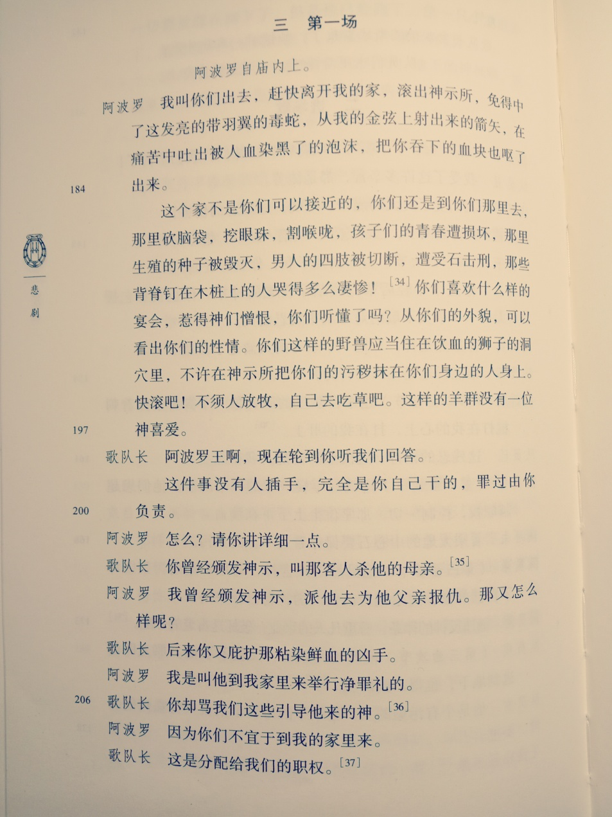
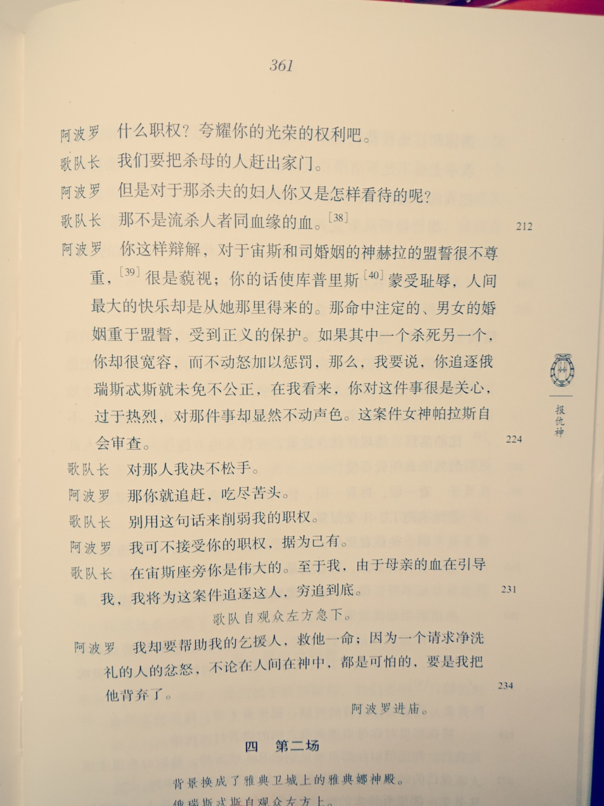
复仇女神与阿波罗的抗辩

Slide 150
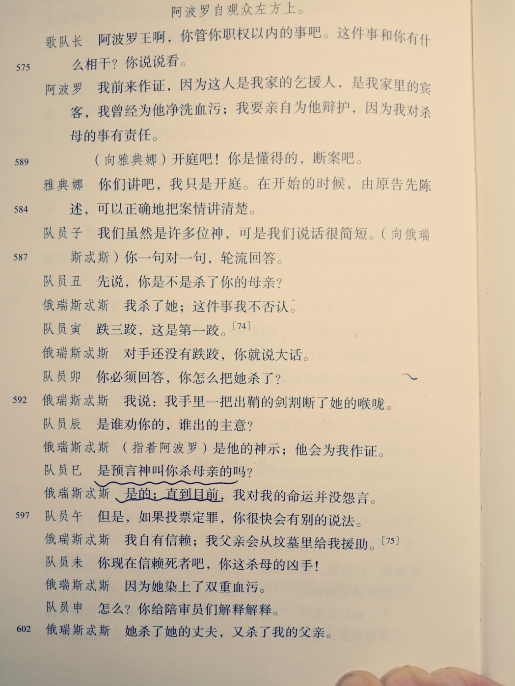
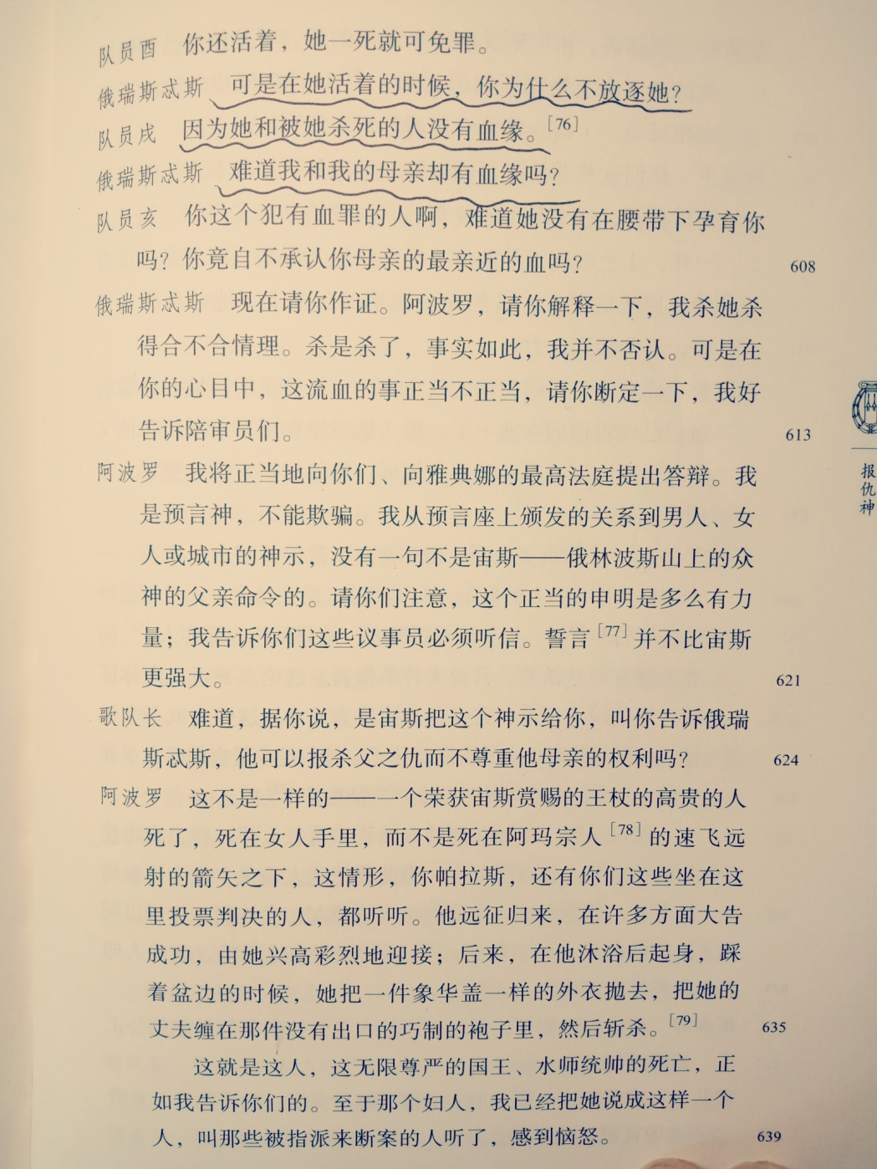

Slide 151
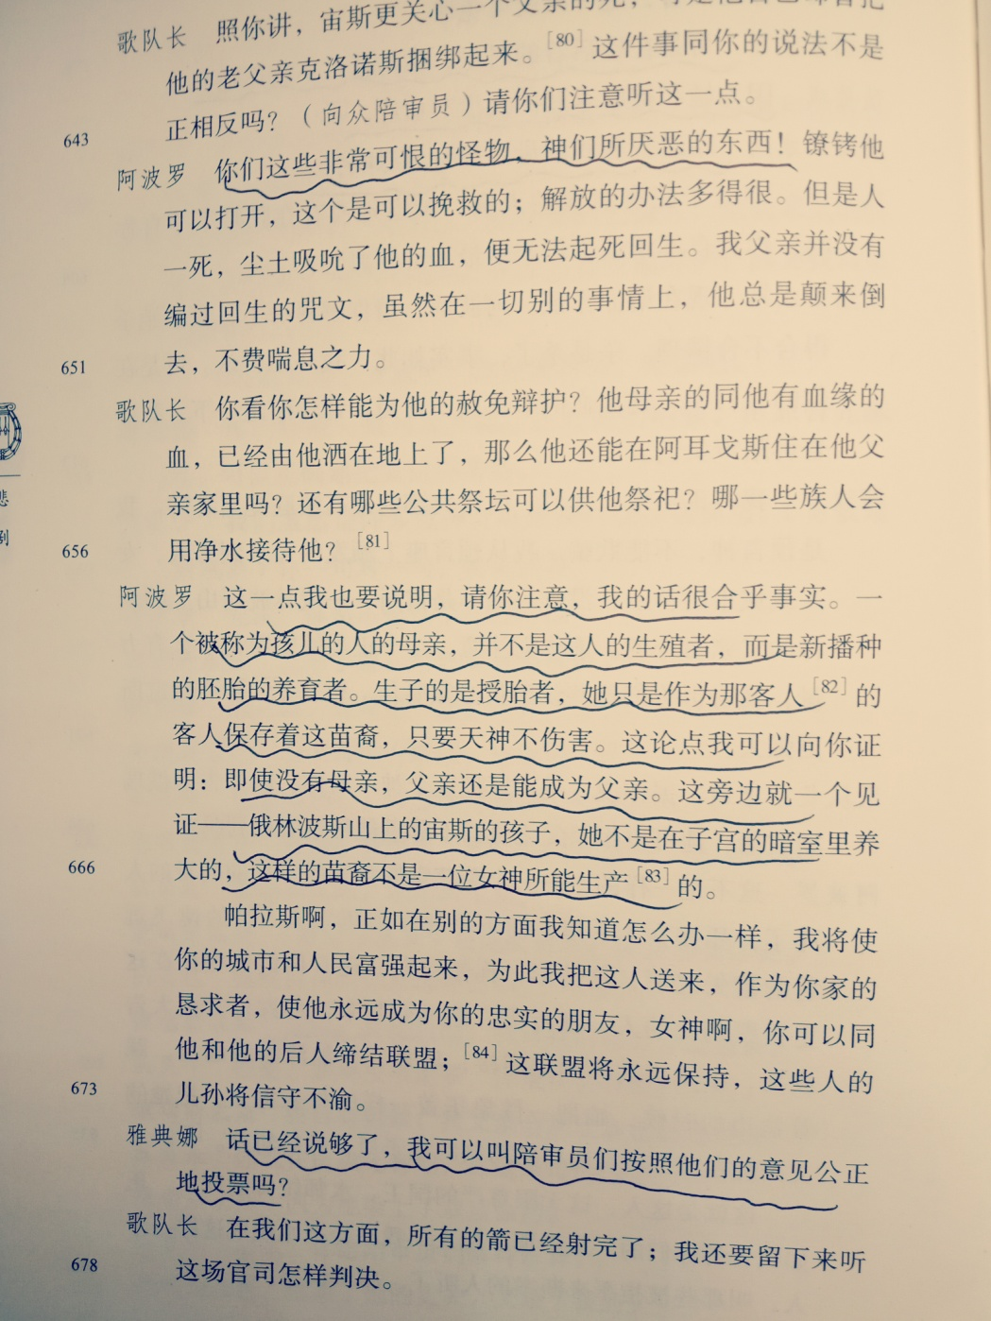
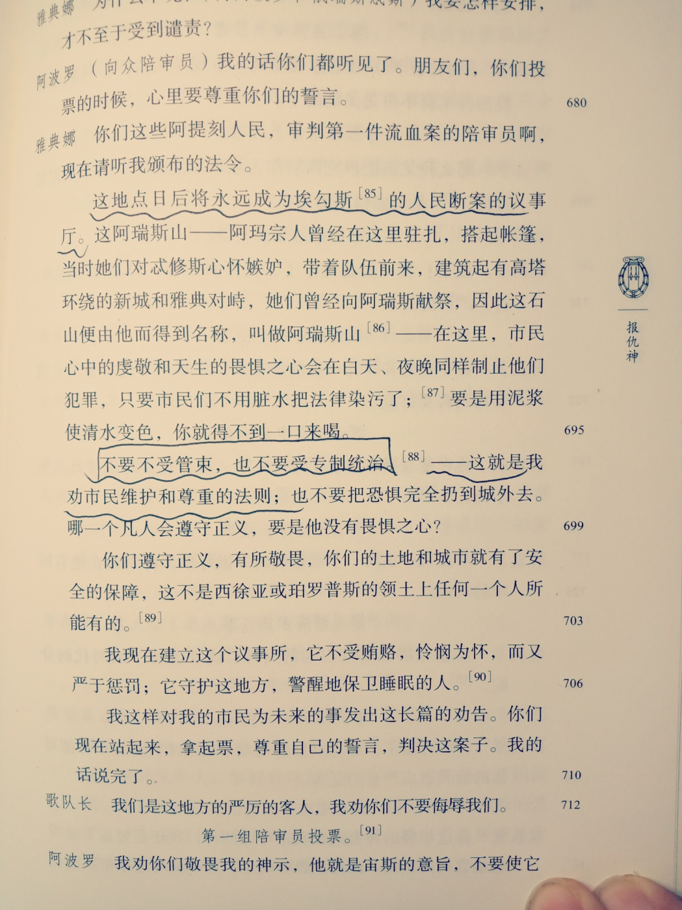

Slide 152
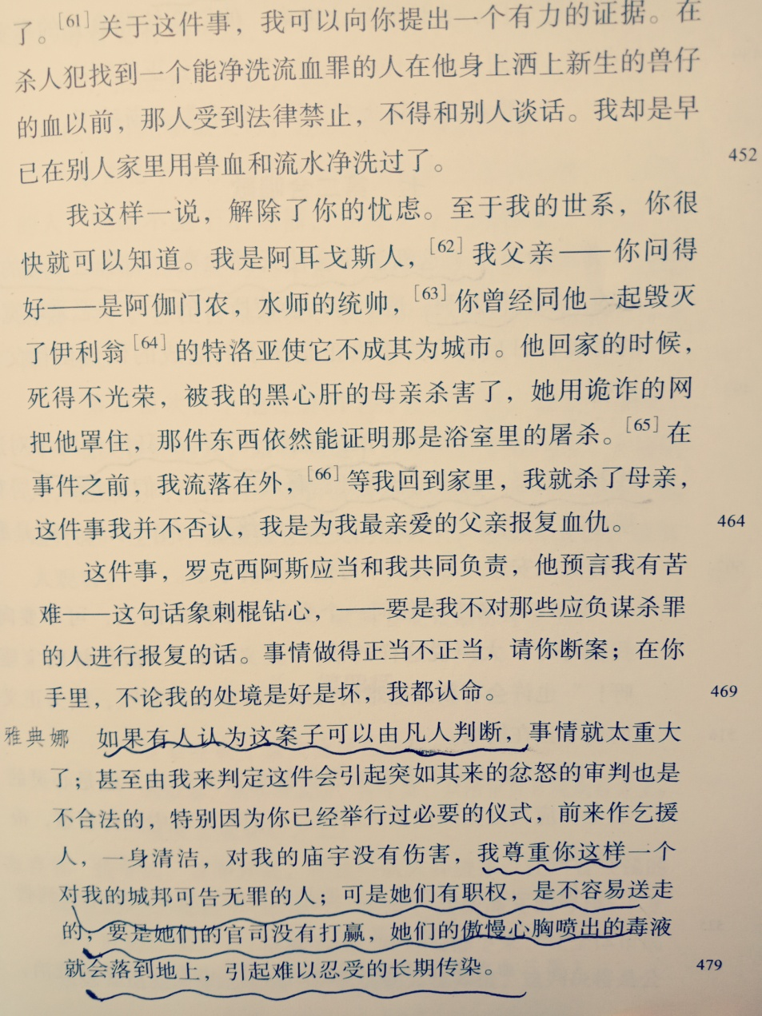
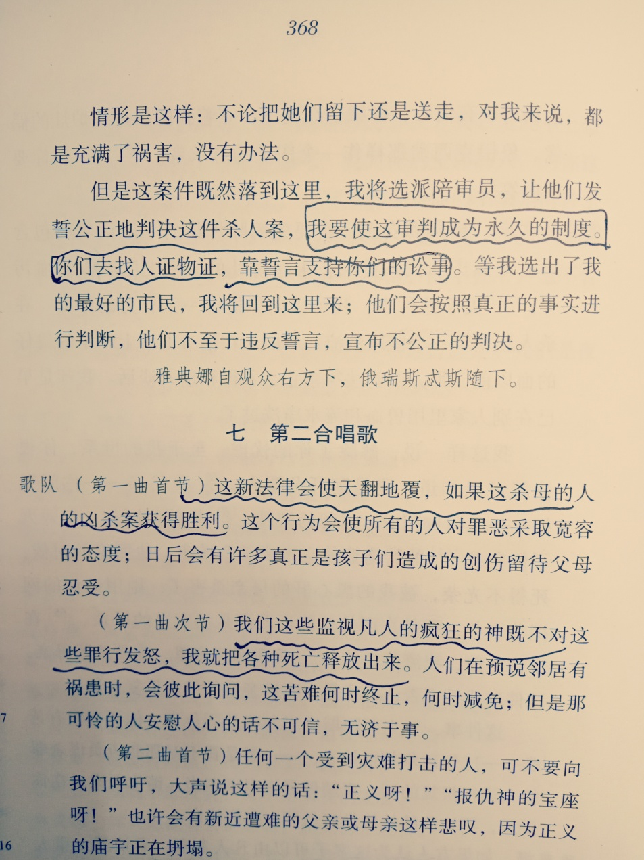
“我要使这审判成为永远的制度”

Slide 153


雅典娜劝说复仇女神

Slide 154



